Slide 1
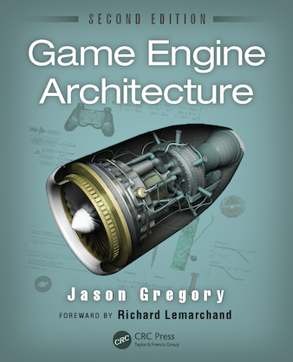
Game Engine Architecture
Chapter 1
Introduction

Slide 2
Structure of a game team
Lots of members, many jobs
Engineers
Artists
Game Designers
Producers
Publisher
Other Staff

Slide 3
Engineers
Build software that makes the game and tools works
Lead by a senior engineer
Runtime programmers
Tools programmers

Slide 4
Artists
Content is king
Lead by the art director
Come in many Flavors
Concept Artists
3D modelers
Texture artists
Lighting artists
Animators
Motion Capture
Sound Design
Voice Actors

Slide 5
Game designers
Responsible for game play
Story line
Puzzles
Levels
Weapons
Employ writers and sometimes ex-engineers

Slide 6
Producers
Manage the schedule
Sometimes act as the senior game designer
Do HR related tasks

Slide 7
Publisher
Often not part of the same company
Handles manufacturing, distribution and marketing
You could be the publisher in an Indie company

Slide 8
Others
Executive management
Marketing
IT department
Administrative staff

Slide 9
What is a Game?
Interactive experience that provides the player with an increasingly challenging sequence of patterns which he or she learns and eventually masters
This includes lots of things, but the core idea is that the “fun” is experience during the eureka moment

Slide 10
Games for us
Focus primarily on 2D and 3D virtual worlds
Most of these can be described as soft real-time agent-based computer simulations
They are simulations of the real world using a mathematical model
They are interactive so have at least one actor or agent
They have loose real-time constraints

Slide 11
What is a game engine
The term game engine arose in the 1990s
Doom by id was at the center
The core components were separated from the game content
Quake III and Unreal were designed with the separation in mind
Sold licenses to their engine and tools
So of you may have done modding using these tools
Game engine are data-driven architectures that are reusable and therefore do not contain game content – mostly true

Slide 12
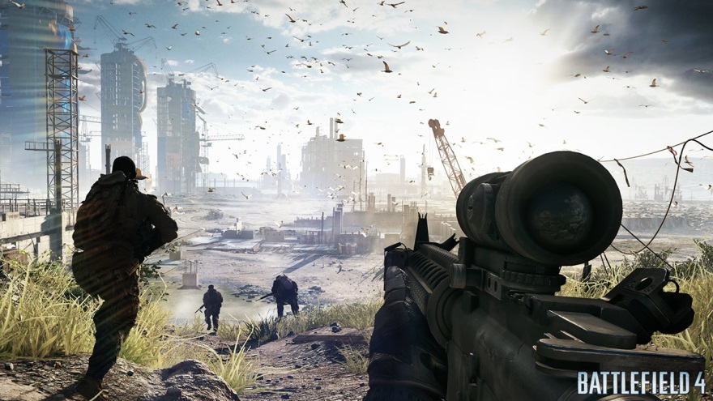
First-person shooters
Games like Unreal, Half-life, Call of Duty
Focus on
Efficient rendering of large 3d worlds
Responsive camera control
High-fidelity animations
Cool weapons
Forgiving physics model
Rendering technology focuses on optimization for the environment

Slide 13
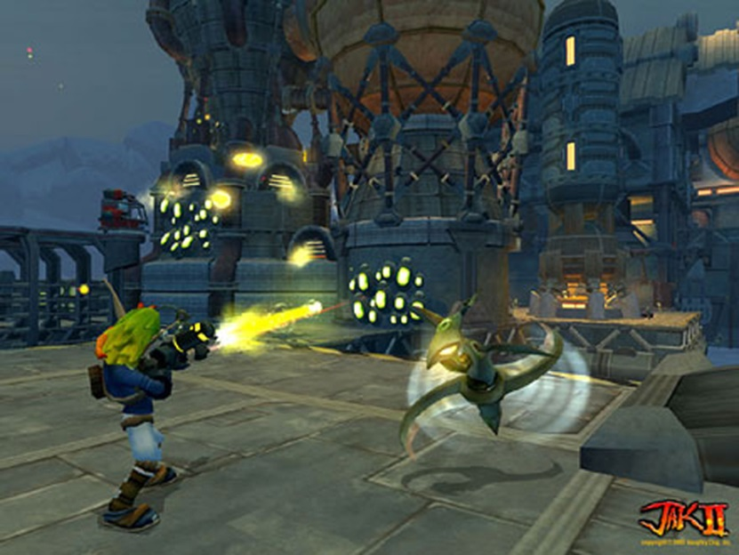
Third-person games
Includes games like Ratchet and Clank, Gears of War
Focus on
Puzzle like elements
Moving environmental objects
Third person follow camera
Complex camera collision system

Slide 14
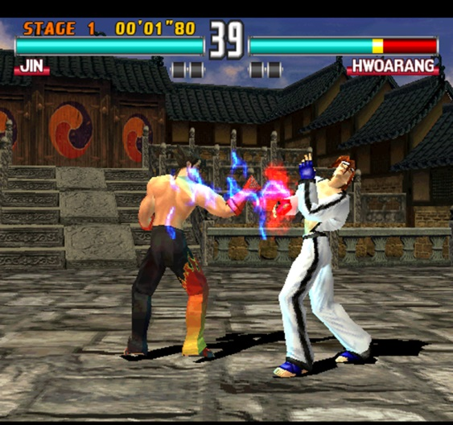
Fighting games
Games like Tekken, Fight Night, and Soul Calibur
Technology focus on
Fighting animations
Hit detection
User input system
Crowds
Awesome character animations and shaders
Physics based cloth and hair

Slide 15
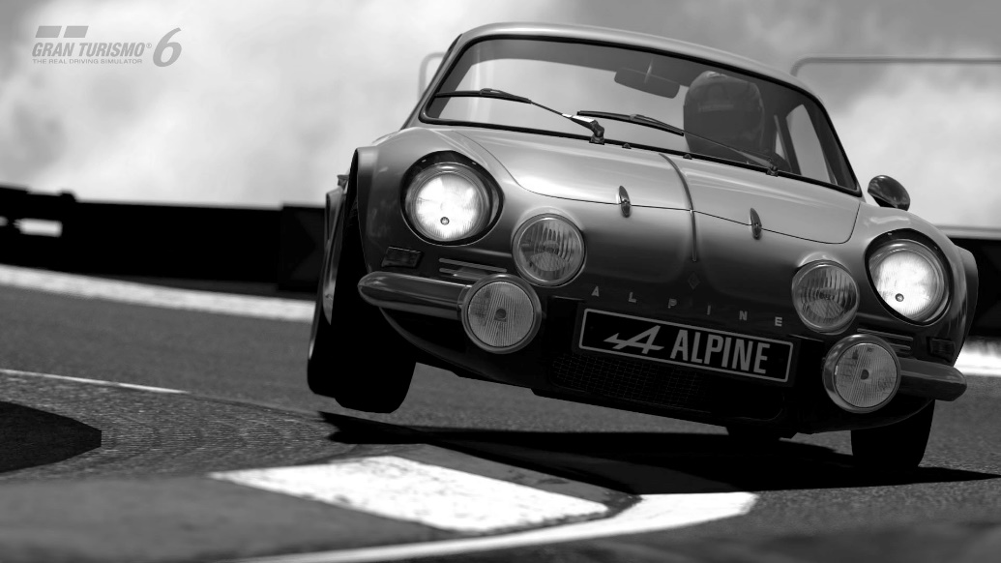
Racing games
Games like Grand Turismo, Mario Kart, and Hydro Thunder
Technology tricks include
Using simple cards for background objects
Track is broken down into sectors
Third-person and first person cameras
Camera collision

Slide 16
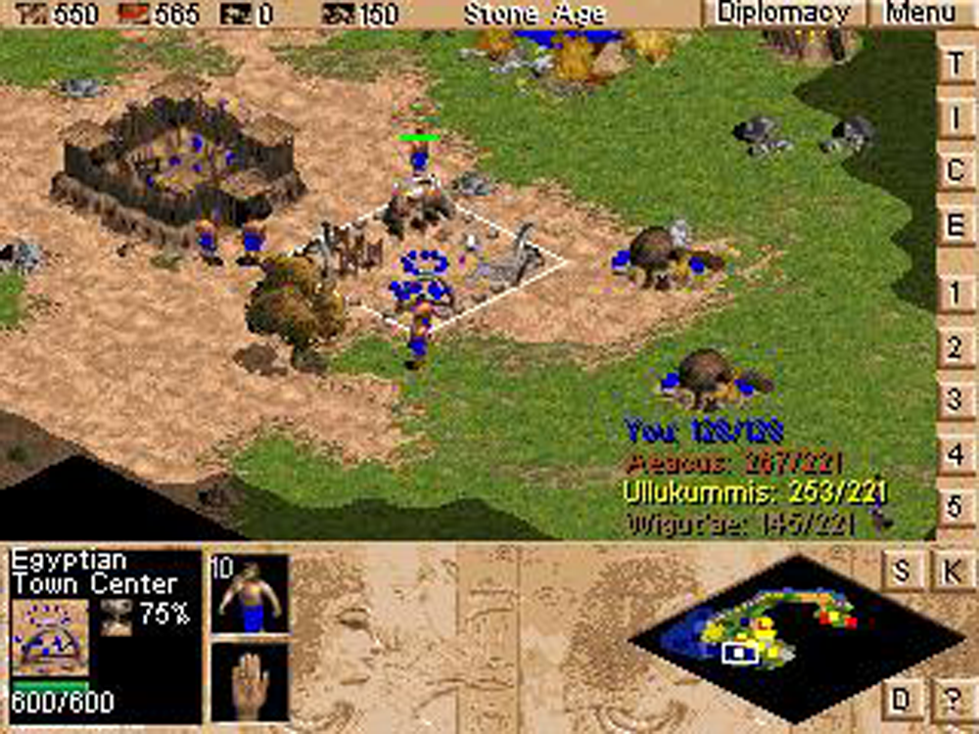
Real-time strategy
Games like Warcraft, Starcraft, Age of Empires
Technology involves
Low resolution characters
Height map based terrain
Complex goal trees
User interaction can take many forms, but reactivity is really important

Slide 17
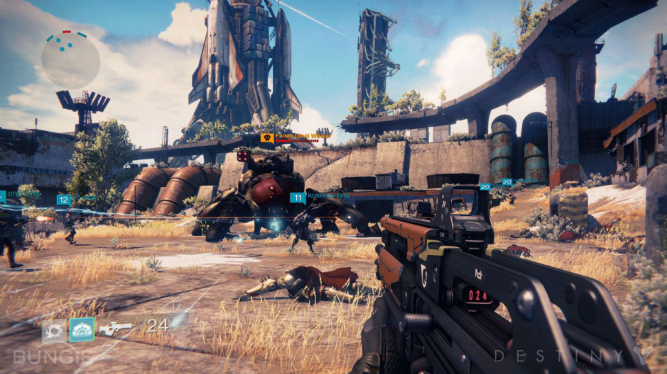
MMOG
Games like World of Warcraft, Star Wars Galaxies, EverQuest
Extra technology over 3rd person include
Server side artifacts for
Sign in/out
State management
Billing
Client side rendering and state management
Network layer for state consistency and cheat detection

Slide 18
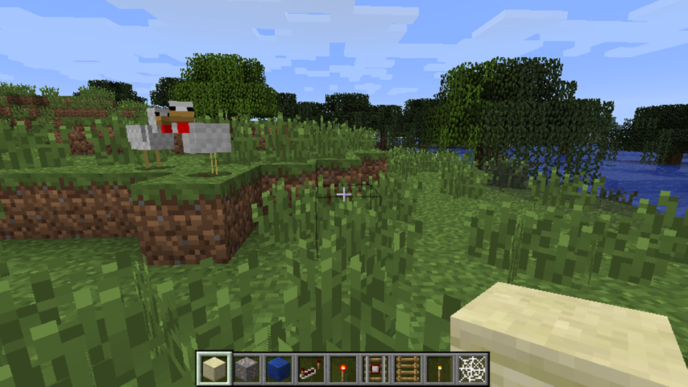
Player-authored content
Allowing the player to build content as part of the game
Different from Mods
Good example include
Little Big Planet series
Minecraft
Fun is in sharing with others
Simplicity is key

Slide 19
Some current engines
Quake family
Used to create many games
Has lineage that extends to modern games like Medal of Honor
Quake and Quake II engines source code are freely available
Unreal Engine
Now at UE4
Very rich tool set – Kismet
Large developers network
Good licensing model – good for small developers

Slide 20
More engines
Unity
Very feature rich
Uses Javascript or C# for scripting
Large community support
Great for cross-platform development
Source Engine
Games like Half-life 2 and its sequels, Team Fortress 2, and Portal
Very powerful with good graphics capabilities and a good toolset
DICE’s Frostbite
Used to create games like Battlefield 4
FrostEd – asset creation tool

Slide 21
Even more engines
CryEngine
Originally developed as a demo for Nvidia
Used to develop numerous games – starting with Far Cry
Sony PhyreEngine
Uses to create games for the Sony platforms
Numerous titles have been written with this engine
Microsoft XNA and MonoGame
Based on C# - easy to use
Used for Xbox and PC games
Not longer supported – replaced by MonoGame

Slide 22
2D Engines
Designed for non-programmers to build apps for Android and iPhone
Examples include
Multimedia Fusion 2
Game Salad Creator
Scratch

Slide 23
Runtime Engine Architecture
Consists of the tools suite and runtime components
Large
Spans hardware to high-level application
Designed in layers
Avoids circular dependencies to maximize reuse and testability

Slide 24
Runtime Engine

Slide 25
Runtime Engine
Low level components
3rd Party SDKs
Platform independence layer
Core systems
Resources manager
Rendering engine
Profiling/Debugging
Collisions and Physics
Animation
Human Interface Devices
Audio
Gameplay foundation system

Slide 26
Low level components
Hardware
This is the system that the game is to run on
Device Drivers
Shield the OS and upper layers from low level device communications details
Operating System
Handles the execution and interruption of multiple programs on a single machine
Very thin on a console

Slide 27
3rd Party SDKs
Data Structure and Algorithms
STL – C++ standard template library data structures, strings, stream-based I/O
Boost – powerful data structures and algorithms
Graphics
OpenGL and DirectX
Collisions and Physics
Havok, PhysX, ODE, Bullet
Character Animation
Artificial Intelligence – Kynapse

Slide 28
Platform independence layer
Allows the engine to be developed without the concern of the underlying platform
Provides wrappers to common target specific operations
Include things like primitive types, network, file systems, etc.

Slide 29
Core systems
Assertions – error checking code
Memory Management
Math library – vector and matrix math, numeric integrators
Custom data structures

Slide 30
Resource manager
Provides a unified interface for accessing assets
The level of complexity is dictated by need
Often the game programmers must do resource loading directly
Engines like UT do unpackaging and complex manipulation of assets in the engine

Slide 31
Rendering engine
Low-level
Scene graph management
Visual effects
Front end

Slide 32
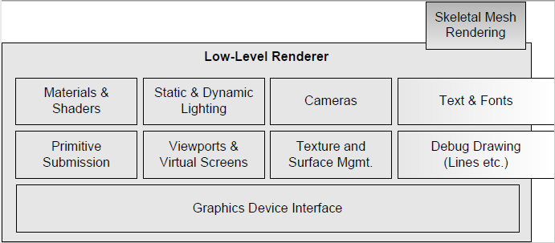
Low-level Renderer
Focuses on rendering primitives as quickly and richly as possible
Does not consider visibility
Graphics Device Interface
Access and enumerate the graphics devices
Initialize the GD
Setup buffering
Others
Representation of the geometric primitives
Abstraction of the camera interface
Material system
Dynamic lighting system
Text and fonts

Slide 33
Scene graph
Limits the number of primitives submitted for rendering
Uses frustum culling – remove things outside of the visible screen
Spatial subdivision
BSP, quadtree, octree, kd-tree

Slide 34
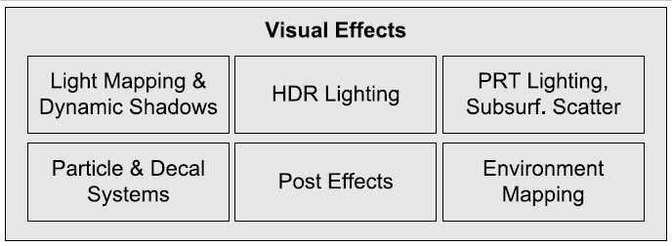
Visual effects
Particle systems
Decal systems
Light mapping
Dynamic shadows
Full screen post effects

Slide 35
Front end
HUD
Menus
GUI for character manipulation
Full-motion video for cut scenes

Slide 36
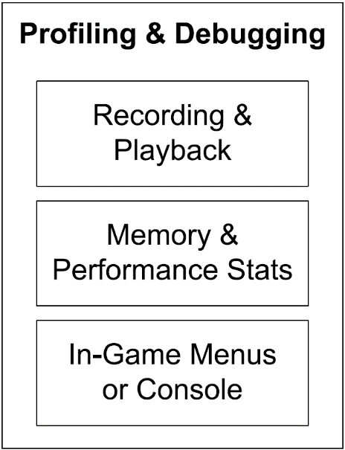
Profiling/Debugging
Code timing
Display stats on the screen
Dumping performance stats
Determining memory usage
Dumping memory usage
Record and playback game events
Print statement output control

Slide 37
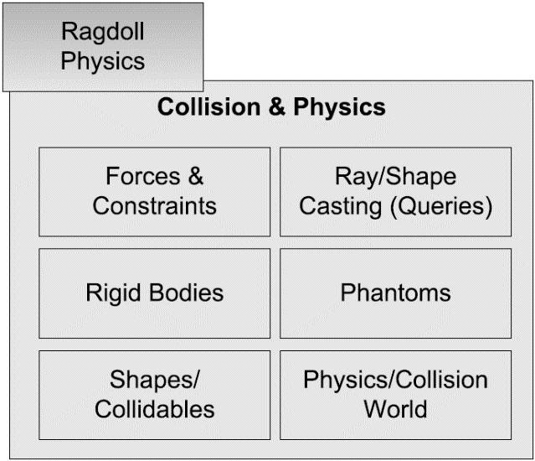
Collisions and Physics
Usually rigid body dynamics
Physics engine creation is its own unique undertaking
Many companies use available libraries
Havok
PhysX
ODE
Bullet

Slide 38
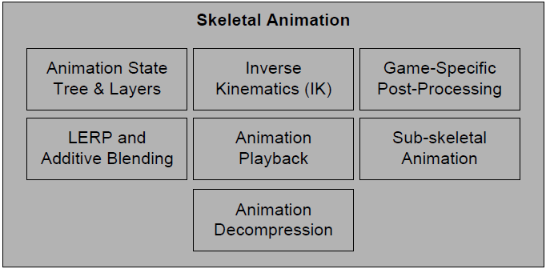
Animation
Five types of animation are used
Sprite/texture animation
Rigid body hierarchy animation
Skeletal animation
Vertex animation
Morphing
Skeletal animations still the most popular

Slide 39
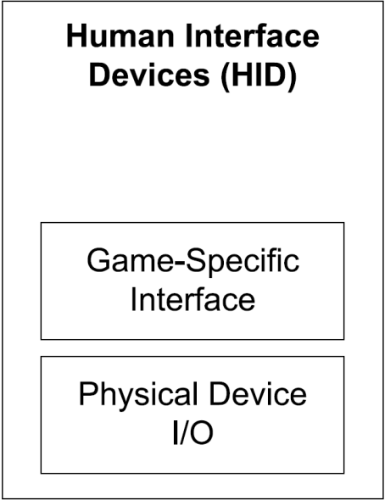
HID
Keyboard and mouse abstractions
Joypads
Specialized controllers
Massages raw data into useful information

Slide 40
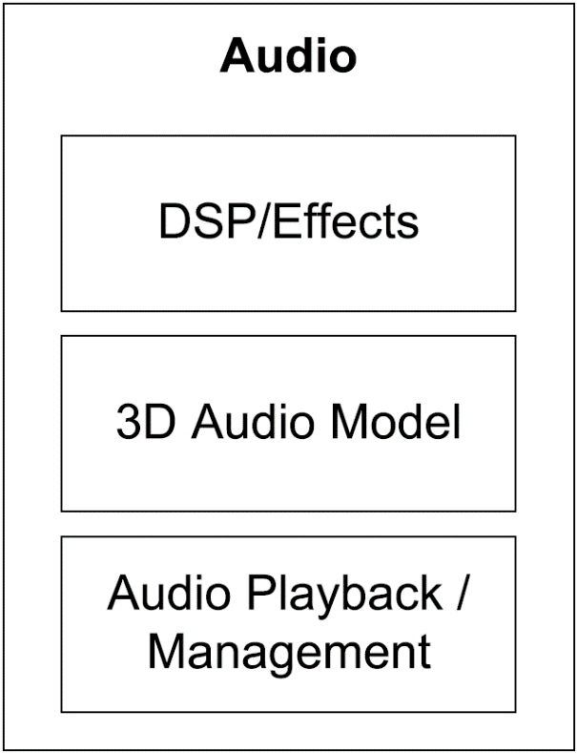
Audio
Often overlooked until the end
Varies in sophistication based on need
Many games use existing tools
XACT
Scream

Slide 41
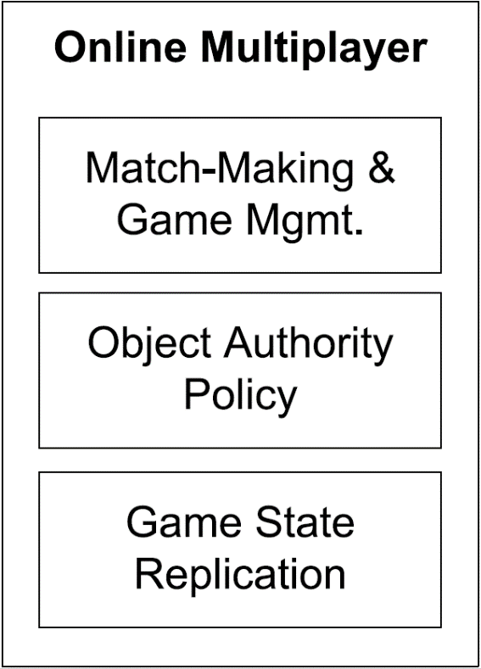
Multiplayer/networking
Four main flavors
Single screen – multiple players on the same screen
Split-screen multiplayer – multiple perspectives on the same screen
Networked multiplayer – multiple computers networked together
Massive multiplayer online games – run in a central server
Difficult to convert single to multiplayer, easy to do the opposite

Slide 42
Gameplay foundation system
Most everything that makes the game a game
World loading
Game object model
Static world elements
Real-time agent simulations

Slide 43
Event system
Objects need to communicate with one another
Easiest to handle this through a common system
Objects send messages that are routed to the event handler

Slide 44
Scripting system
Allows for the creation on new game logic without recompiling
Speeds software development considerably

Slide 45
Artificial intelligence foundations
Provides AI building blocks
Path planning
Nav mesh generation
Object avoidance
Autodesk has a middleware called Gameware that provides many of these features

Slide 46
Game-specific subsystems
All of the specific stuff needed for a game
This layer could be considered outside of the game engine itself

Slide 47
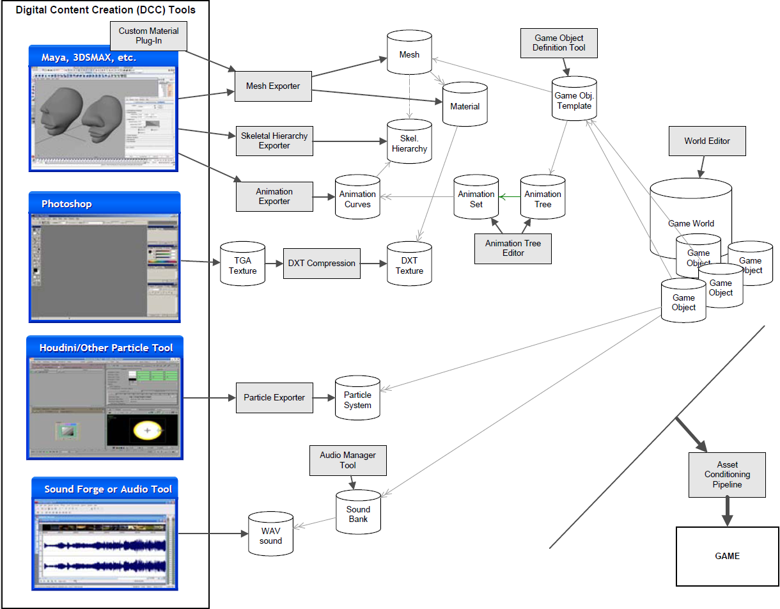
Tools and the asset pipeline

Slide 48
Digital content creation
Game engines deal with data in many forms
The data has to be created somehow
3D Meshes
Textures
Sound
Animations
Often created using outside tools
Maya/3ds Max
Photoshop
SoundForge
DCC tools need to be easy to use and very reliable

Slide 49
Assets conditioning pipeline
DCC tools produce a variety of file formats that are not optimized for game
Game engines usually store the data in an easy to read and platform specific format
The ACP does this translation

Slide 50
Conditioning assets
3D Model/Mesh data
3D Models – Must be properly tessellated
Brush Geometry – A collection of convex hulls with multiple planes
Skeletal animation data
Must be compressed and converted to properly work
Audio data
Should convert multiple formats to a single format for the target system
Particle system data
Usually need a custom editing tool within the engine

Slide 51
Game world editor
Usually integrated into the engine
Essential to allow game designers to work with the engine
Many examples
UnrealEd
Hammer
Radiant

Slide 52
Resource database
Need a way to store and manage the vast amounts of data
Some companies use relational databases
MySQL or Oracle
Some companies use version control software
Subversion, Perforce, or GIT
Still others use custom software
Naughty Dog uses a custom GUI called Builder

Slide 53
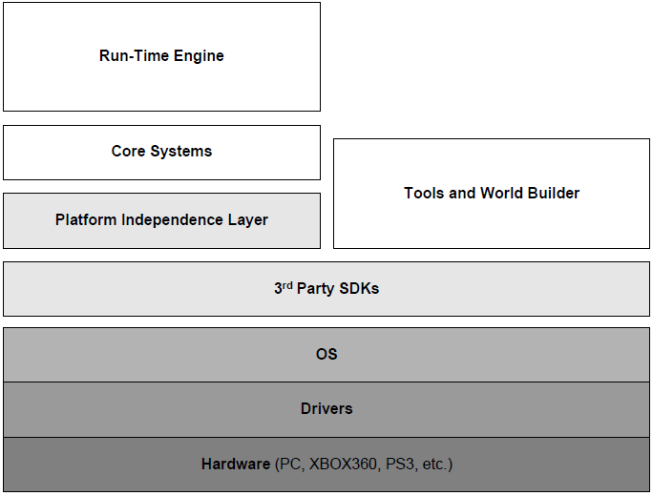
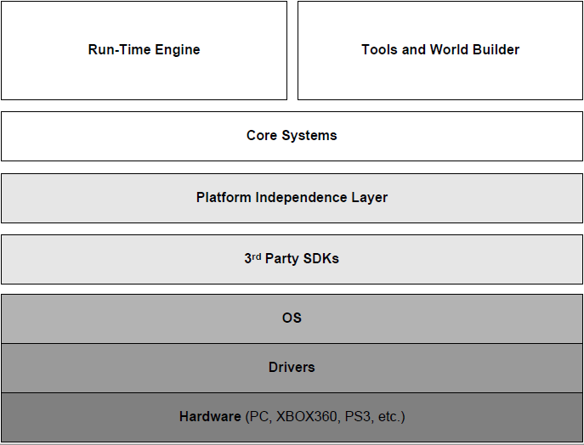
Approaches to Tool Architecture
Stand alone
Integrated

Slide 54
Web-based tools
Various uses
Asset management
Scheduling
Bug management
Easier to build
Usually easier to build than a stand alone application
Easier to update without forcing a reinstall
If it just needs to present tabular data and have forms – use a web interface

