Slide 1
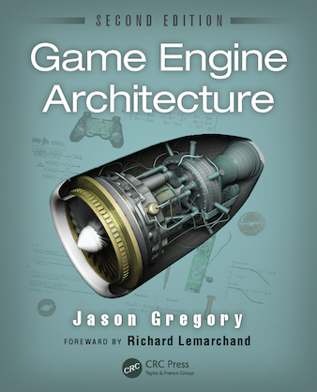
Game Engine Architecture
Chapter 4
3D Math for Games

Slide 2
Topics
Math for games
Points and Vectors
Matrices
Quaternions
Comparison of rotational representations
Other useful math objects
Hardware-accelerated SIMD Math
Random Number Generation

Slide 3
2D as a Start
Most operations in 3D also make sense in 2D
Always use 2D as a basis, it’ll help

Slide 4
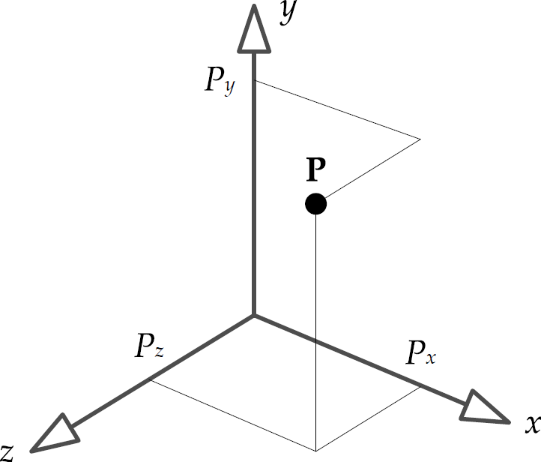
Points and vectors
A point is a location in n-dimensional space
Usually represented in Cartesian space
Two or three mutually perpendicular axes
A point is a triple of numbers (P_{x},P_{y},P_{z})

Slide 5
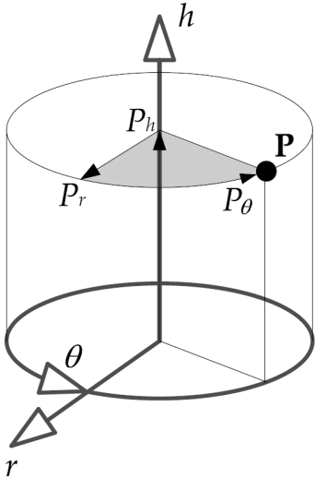
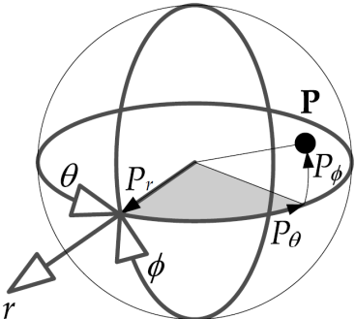
Other systems
Cylindrical
Employs a height axis (h), a radial axis (r), and a yaw angle (θ)
Points represented as (P_{h},P_{r},P_{θ})
Spherical
Pitch(φ), yaw(θ), and radial (r)
Points represented as (P_{r},P_{φ},P_{θ})

Slide 6
Picking a system
Most people use Cartesian
Sometimes it is easier to use something else
Swirling objects around a character are easier in cylindrical
Explosions may be easier in spherical

Slide 7
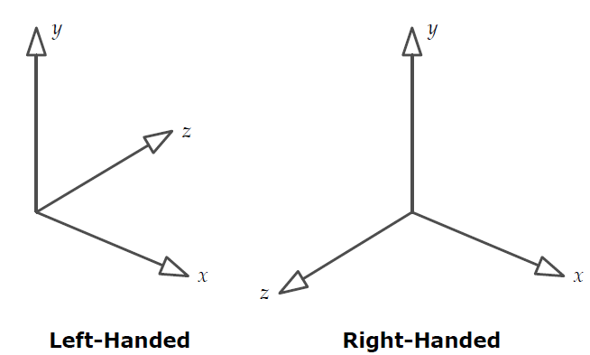
Left vs Right
When using Cartesian coordinates, you get to choose either left or right handed coordinate systems

Slide 8
Left vs Right
Converting is easy, flip the direction of any one axis.
Graphics programmers typically pick left-handed with y pointing up, x to the right, and z pointing into the screen
Helps with z-buffering

Slide 9
Vectors
Vector have
Magnitude
Direction
Extend from the tail toward the head
Differs from a scalar because of the direction
Technically represents an offset relative to a known point
Can be used to represent a point if it is relative to the origin
Called a position vector versus direction vector

Slide 10
Basis Vectors
Sometimes useful to define orthogonal unit vectors
i is along the x-axis
j is along the y-axis
k is along the z-axis
Can now represent points as the sum of scalars multiplied by the unit vectors
$$\left(5,3,−2\right)=5i+3j−2k$$

Slide 11
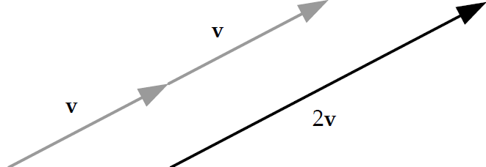
Vector Operations
Multiply by a scalar - scales the magnitude without affecting direction
$$sa=({sa}_{x},{sa}_{y},{sa}_{z})$$
Non-uniform scaling
$s⨂a=(s_{x}a_{x},s_{y}a_{y}$, $s_{z}a_{z}$)
$$aS= \left[\begin{matrix}a_{x} & a_{y} & a_{y}\end{matrix}\right]\left[\begin{matrix}s_{x} & 0 & 0 \\ 0 & s_{y} & 0 \\ 0 & 0 & s_{z}\end{matrix}\right]=\left[\begin{matrix}a_{x}s_{x} & a_{y}s_{y} & a_{z}s_{z}\end{matrix}\right]$$

Slide 12
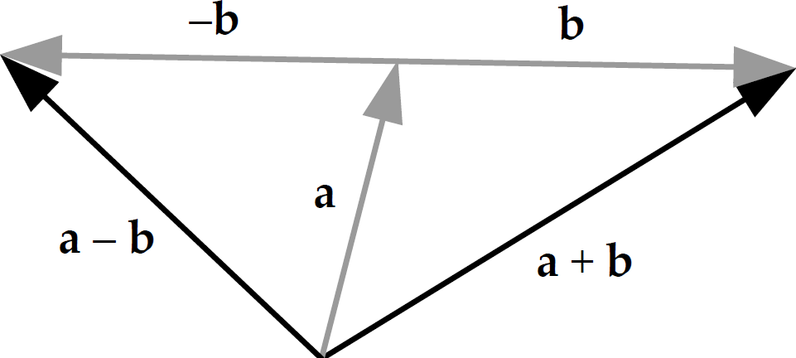
Vector operations
Addition and Subtraction
$$a+b=\left[\left({ a}_{x}+b_{x}\right),\left(a_{y}+b_{y}\right),\left(a_{z}+b_{z}\right)\right]$$
$$a−b=\left[\left({ a}_{x}−b_{x}\right),\left(a_{y}−b_{y}\right),\left(a_{z}−b_{z}\right)\right]$$
Points and directions
direction + direction = direction
direction – direction = direction
point + direction = point
point – point = direction
point + point = crap

Slide 13
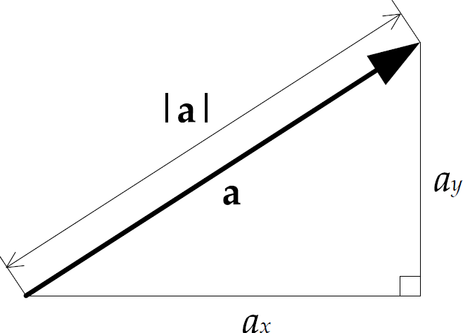
Vector Operations
Calculating magnitude – think of it as distance
$$\left|a\right|=\sqrt{a_{x}^{2}+a_{y}^{2}+a_{z}^{2}}$$

Slide 14
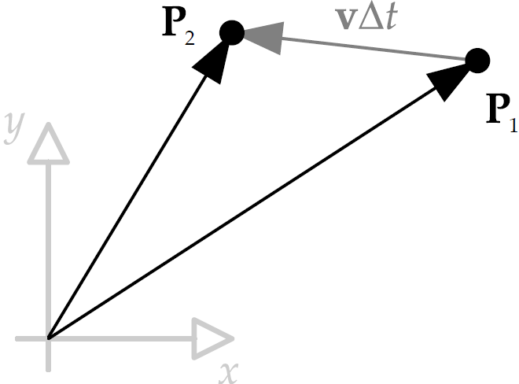
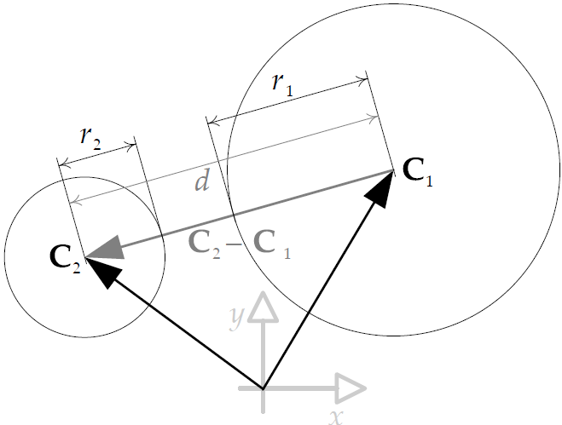
Use of Vector Operations
Moving objects
$P_{2}=P_{1}+v∆t$
Object collision
if $d<r_{1}+r_{2}$ then they collide
Faster to compare $d^{2}< {\left(r_{1}+r_{2}\right)}^{2}$

Slide 15
Unit Vectors
Sometimes you need a unit length vector in the same direction as the original – called normalization, not a normal vector
$$u=\frac{v}{\left|v\right|}=\frac{1}{v}v$$

Slide 16
DOT product
Add the components of the vector
$a⋅b= a_{x}b_{x}+a_{y}b_{y}$+$a_{z}b_{z}$
Also written as
$$a⋅b= \left|a\right|\left|b\right|\cos\left(θ\right)$$
It is commutative, distributive, and works with scalar multiplication
$$a⋅b=b⋅a$$
$$a⋅\left(b+c\right)=a⋅b+a⋅c$$
$$sa⋅b=a⋅sb=s\left(a⋅b\right)$$

Slide 17
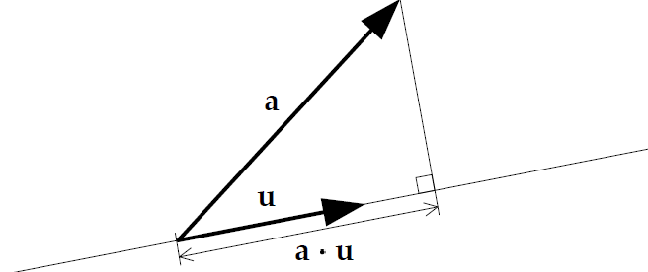
Projection
If u is a unit vector
then the dot product of a and u represents the length of the projection of a onto u

Slide 18
Magnitude
You can use the dot product to find the magnitude as well
$${\left|a\right|}^{2}=a⋅a$$
$$\left|a\right|=\sqrt{a⋅a}$$

Slide 19
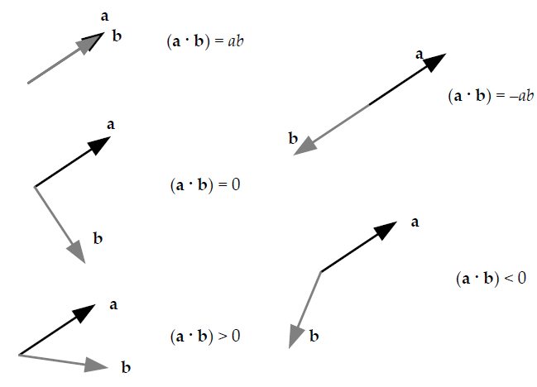
Useful Dot Product Tests

Slide 20
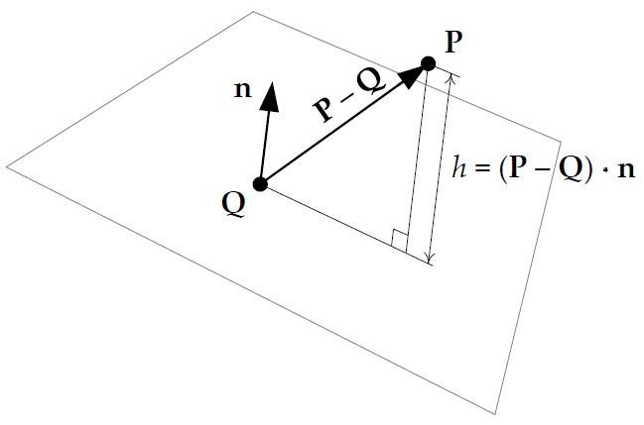
Other applications
Visibility – can player P see enemy E
v = E-P gives the relative position of E in relation to P
if f is the facing vector of P then when v⋅f is negative E is behind P
If we define a plane as a point Q and a normal n then we can find the height h of a point P above the plane using projection

Slide 21
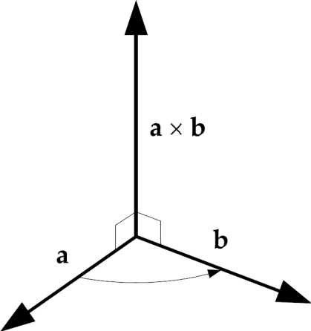
Cross Product
Yields another vector that is perpendicular to the vectors being multiplied
$$a×b=\left[\left(a_{y}b_{z}−a_{z}b_{y}\right),\left(a_{z}b_{x}−a_{x}b_{z}\right),\left(a_{x}b_{y}−a_{y}b_{x}\right)\right]$$
$$=\left(a_{y}b_{z}−a_{z}b_{y}\right)i+\left(a_{z}b_{x}−a_{x}b_{z}\right)j+\left(a_{x}b_{y}−a_{y}b_{x}\right)k$$

Slide 22
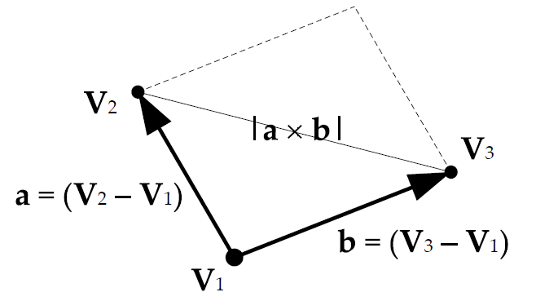
Magnitude of X-product
Magnitude of the cross product is the area of the parallelogram formed by the two vectors
$$a×b=\left|a\right|\left|b\right|sin\left(θ\right)$$
$$A_{triangle}=\frac{1}{2}\left|\left(V_{2}−V_{1}\right)×\left(V_{3}−V_{1}\right)\right|$$

Slide 23
Properties of the cross product
It is not commutative
$$a×b≠b×a$$
It is anti-commutative
$$a×b=−b×a$$
Distributive over addition
$$a×\left(b+c\right)=a×b+(a×c)$$
Combine with scalar multiplication
$$\left(sa\right)×b=a×\left(sb\right)=s(a×b)$$
Cartesian basis vector are related by cross product
$$\left(i×j\right)=k \left(j×k\right)=i \left(k×i\right)=j$$

Slide 24
Uses of the cross product
Finding a vector that is perpendicular to two other vectors
Finding the normal vector to a plane
$$n=normalize\left(\left(P_{2}−P_{1}\right)×\left(P_{3}−P_{1}\right)\right)$$
Calculate torque
Given a force F and a vector r from the center of mass the torque is
$$N=r×F$$

Slide 25
Pseudovectors
Cross product doesn’t actually produce a vector
Creates a pseudovector
Difference is quite subtle – only apparent on reflection
Vectors reflect to mirror image
Pseudovectors reflect to mirror image, but also change direction
Vectors
-Position
-Velocity
-Acceleration
Psuedovectors
-Angular velocity
-Magnetic fields
-Normals to a surface

Slide 26
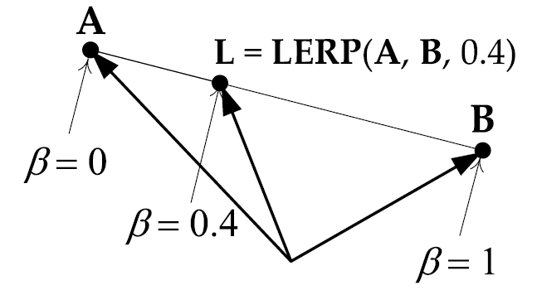
LERP
A simple linear interpolation between 2 points
(β ranges from 0 to 1)
$$L=LERP\left(A,B,β\right)=\left(1−β\right)A+βB$$
$$=\left[\left(1−β\right)A_{x}+βB_{x},\left(1−β\right)A_{y}+βB_{y},\left(1−β\right)A_{z}+βB_{z}\right]$$

Slide 27
Matrices
A matrix is a rectangular array of m x n scalars
$$M=\left[\begin{matrix}M_{11} & M_{12} & M_{13} \\ M_{21} & M_{22} & M_{23} \\ M_{31} & M_{32} & M_{33}\end{matrix}\right]$$
They are convenient for representing translation, rotation, and scale operations
When all rows and columns are of unit magnitude it is called isotropic or orthonormal – represent pure rotations

Slide 28
4x4 Matrix
Sometimes 4x4 matrices are used to represent 3D transformations
They call them transformation matrices
Affine matrix is a 4 x 4 transformation matrix that
Preserves parallelism of line
Relative distance ratio
Not necessarily absolute lengths and angles
Affine matrix is any combination of translation, rotations, scale or shear

Slide 29
Matrix Multiplication
The product of two matrices is written as P=AB, if A and B are transformation matrices then so is P
Multiplication is done by taking the dot products of the rows of A and the columns of B. The inner dimensions must be the same n_{A}=m_{B}.

Slide 30
Multiplication
$$P=AB$$
$$P=\left[\begin{matrix}P_{11}=A_{row1}⋅B_{col1} & P_{12}=A_{row1}⋅B_{col2} & P_{13}=A_{row1}⋅B_{col3} \\ P_{21}=A_{row2}⋅B_{col1} & P_{22}=A_{row2}⋅B_{col2} & P_{23}=A_{row2}⋅B_{col3} \\ P_{31}=A_{row3}⋅B_{col1} & P_{32}=A_{row3}⋅B_{col2} & P_{33}=A_{row3}⋅B_{col3}\end{matrix} \right]$$
$$AB≠BA$$

Slide 31
Points and Vectors as Matrices
Can represent points or vectors as row matrices (1 x n) or column matrices (n x 1)
For example v = (3, 4, -1) can be
$$v_{1}=\left[\begin{matrix}3 & 4 & −1\end{matrix}\right]$$
$$v_{2}=\left[\begin{matrix}3 \\ 4 \\ −1\end{matrix}\right]=v_{1}^{T}$$

Slide 32
Vector X Matrix
If multiplying a row vector (1 x n) by an n x n matrix, the vector appears on the left
$v_{1×n}^{′}=v_{1×n}M_{n×n}$
If multiplying an n x n matrix by a column vector (n x 1) the vector appears on the right
$$v_{n×1}^{′}={M_{n×n}v}_{n×1}$$
$v^{′}=\left(\left(\left(vA\right)B\right)C\right)$ row vectors: read left-to-right
$v^{′T}=\left(C^{T}\left(B^{T}\left(A^{T}v^{T}\right)\right)\right)$ column vectors: read right-to-left

Slide 33
Identity matrix
Usually donated by the symbol I
Always square (n==m) with the diagonals = 1 and 0 everywhere else
$$I_{3×3}=\left[\begin{matrix}1 & 0 & 0 \\ 0 & 1 & 0 \\ 0 & 0 & 1\end{matrix}\right]$$
$$AI≡IA≡A$$

Slide 34
Inverse Matrix
An inverse matrix A (denoted A⁻¹) undoes the effects of matrix A
When you multiply a matrix by its inverse, the result is always the identity matrix $A(A^{−1})≡\left(A^{−1}\right)A≡I$
Not all matrices have inverses. The ones in game development do.
Undoing concatenated matrices requires special care
$${\left(ABC\right)}^{−1}=C^{−1}B^{−1}A^{−1}$$

Slide 35
Transposition
The transpose of matrix M is M^{T}
Found by reflecting across the diagonal
$${\left[\begin{matrix}a & b & c \\ d & e & f \\ g & h & i\end{matrix}\right]}^{T}=\left[\begin{matrix}a & d & g \\ b & e & h \\ c & f & i\end{matrix}\right]$$
Inverse of an orthonormal (pure rotation) matrix is equal to its transpose
Transpose of concatenated matrices is handled like inverse
$${\left(ABC\right)}^{T}=C^{T}B^{T}A^{T}$$

Slide 36
Homogeneous Coordinates
A 2x2 matrix can be used to represent rotations in 2 dimensions
$$\left[\begin{matrix}r_{x}^{′} & r_{y}^{′}\end{matrix}\right]=\left[\begin{matrix}r_{x} & r_{y}\end{matrix}\right]\left[\begin{matrix}\cos{φ} & \sin{φ} \\ −\sin{φ} & \cos{φ}\end{matrix}\right]$$
The same is true for 3 dimensions
$$\left[\begin{matrix}r_{x}^{′} & r_{y}^{′} & r_{z}^{′}\end{matrix}\right]=\left[\begin{matrix}r_{x} & r_{y} & r_{z}\end{matrix}\right]\left[\begin{matrix}\cos{φ} & \sin{φ} & 0 \\ −\sin{φ} & \cos{φ} & 0 \\ 0 & 0 & 1\end{matrix}\right]$$

Slide 37
Translations?
Can you use a 3 x 3 to represent a translation?
Nope $r+t=\left[\begin{matrix}r_{x}+t_{x} & r_{y}+t_{y} & r_{z}+t_{z}\end{matrix}\right]$
We can however is we use a 4 x 4
$$r+t=\left[\begin{matrix}r_{x} & r_{y} & r_{z} & 1\end{matrix}\right]\left[\begin{matrix}1 & 0 & 0 & 0 \\ 0 & 1 & 0 & 0 \\ 0 & 0 & 1 & 0 \\ t_{x} & t_{x} & t_{x} & 1\end{matrix}\right]$$
$$=\left[\begin{matrix}r_{x}+t_{x} & r_{y}+t_{y} & r_{z}+t_{z} & 1\end{matrix}\right]$$

Slide 38
Points versus Vectors
Remember points and vectors are different
Points can be translated, vectors cannot
We can achieve this by setting the last value in the homogenized vector to 1 for point and 0 for vectors
Eliminates the effects of translations
$$\left[\begin{matrix}v & 0\end{matrix}\right]\left[\begin{matrix}U & 0 \\ t & 1\end{matrix}\right]=\left[\begin{matrix}(vU+0t) & 0\end{matrix}\right]= \left[\begin{matrix}vU & 0\end{matrix}\right]$$
Technically we can convert from 4D homogeneous to 3D non-homogeneous by dividing
$$\left[\begin{matrix}x & y & z & w\end{matrix}\right]≡\left[\begin{matrix}\frac{x}{w} & \frac{y}{w} & \frac{z}{w}\end{matrix}\right]$$
Now makes sense why we set w=0 for vectors

Slide 39
Atomic transformation matrices
Notice that a 4 x 4 transformation matrix can be partitioned into 4 components
$$M_{affine}=\left[\begin{matrix}U_{3×3} & 0_{3×1} \\ t_{1×3} & 1\end{matrix}\right]$$
U represents rotation and/or scaling
t represents the translation
0 =[0 0 0]^{T}
a scalar 1

Slide 40
Point times Atomic
When you multiply a point by a matrix the result is
$$\left[\begin{matrix}r_{1×3}^{′} & 1\end{matrix}\right]=\left[\begin{matrix}r_{1×3} & 1\end{matrix}\right]\left[\begin{matrix}U_{3×3} & 0_{3×1} \\ t_{1×3} & 1\end{matrix}\right]=\left[\begin{matrix}rU+t & 1\end{matrix}\right]$$

Slide 41
Atomic translation
$r+t=\left[\begin{matrix}r_{x} & r_{y} & r_{z} & 1\end{matrix}\right]\left[\begin{matrix}1 & 0 & 0 & 0 \\ 0 & 1 & 0 & 0 \\ 0 & 0 & 1 & 0 \\ t_{x} & t_{x} & t_{x} & 1\end{matrix}\right]$ $\left[\begin{matrix}r & 1\end{matrix}\right]\left[\begin{matrix}I & 0 \\ t & 1\end{matrix}\right]=\left[\begin{matrix}r+t & 1\end{matrix}\right]$
The inversion is just the negation of t
Previous translation matrix
Now be written as

Slide 42
Atomic Rotation
Pure rotations have the form

Slide 43
Rotations
The 1 within the rotation matrix always appears on the axis of rotation, the sine and cosine are off axis
Positive rotations go from
x to y - about z
y to z - about x
z to x - about y - this explains the transpose of the matrix
The inverse of a pure rotation is its transpose

Slide 44
Scaling
$rS=\left[\begin{matrix}r_{x} & r_{y} & r_{z} & 1\end{matrix}\right]\left[\begin{matrix}s_{x} & 0 & 0 & 0 \\ 0 & s_{y} & 0 & 0 \\ 0 & 0 & s_{z} & 0 \\ 0 & 0 & 0 & 1\end{matrix}\right]$ $\left[\begin{matrix}r & 1\end{matrix}\right]\left[\begin{matrix}S_{3×3} & 0 \\ 0 & 1\end{matrix}\right]=\left[\begin{matrix}rS_{3×3} & 1\end{matrix}\right]$
To invert scaling just use the reciprocals of the scaling factors
If all the scaling factors are the same it is called uniform scaling
Written as
Shorthand of

Slide 45
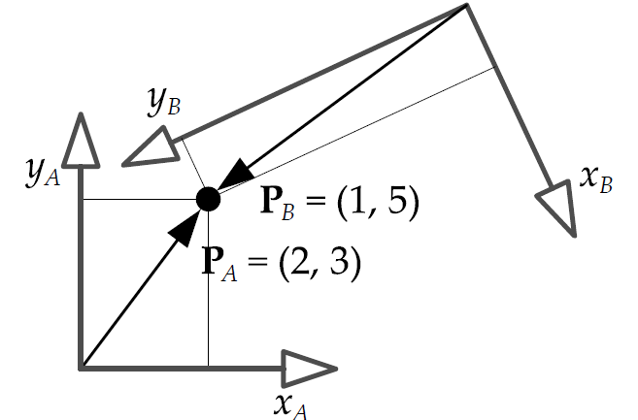
Coordinate Spaces
We can think of a point as being a vector relative to a given set of axes
The axes are just for a frame of reference and are referred to as a coordinate space

Slide 46
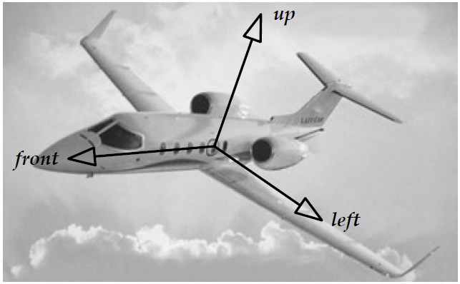
Model space
When a model is created, the vertices are relative to a coordinate system called model space
Model space origin is usually in the center of the object
Model space axes are usually named something like front, left, and up

Slide 47
Mapping model to world
The mapping can be arbitrary
$Front=k, Left=i, Up=j$ or $Front=i, Right=k, Up=j$
Why use model space?
Consider pitch, yaw, and roll
They cannot be represented in terms of i, j, k

Slide 48
World Space
A fixed coordinate system where the objects, orientations, and scales are defined
Center usually placed at the center of the playable area
The orientation is arbitrary but usually y or z is up

Slide 49
Model to world

Slide 50
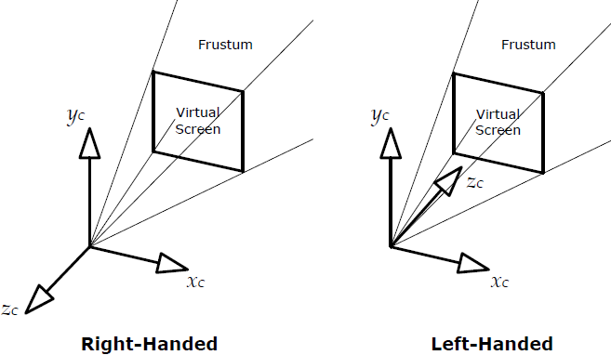
View space
A coordinate space fixed to the location of the camera

Slide 51
Change of basis
All coordinate spaces are relative
You must specify them in relation to another space
This implies a hierarchy of spaces
The world space is at the root
The camera has a location in world space, so its view space has the world space as a parent

Slide 52
Change of basis matrix
The matrix from transforming a child to parent space is called
$$M_{C→P}$$
With the matrix any child-space position can be transformed into a parent-space position
$$P_{P}=P_{C}M_{C→P}$$
$$M_{C→P}=\left[\begin{matrix}i_{C} & 0 \\ j_{C} & 0 \\ k_{C} & 0 \\ t_{C} & 1\end{matrix}\right]=\left[\begin{matrix}i_{Cx} & i_{Cy} & i_{Cz} & 0 \\ j_{Cx} & j_{Cy} & j_{Cz} & 0 \\ k_{Cx} & k_{Cy} & k_{Cz} & 0 \\ t_{Cx} & t_{Cy} & t_{Cz} & 1\end{matrix}\right]$$
i_{C} unit x-axis basis vector of child in parent space
j_{C} unit y-axis basis vector of child in parent space
k_{C} unit z-axis basis vector of child in parent space
t_{C} translation of child relative to parent space

Slide 53
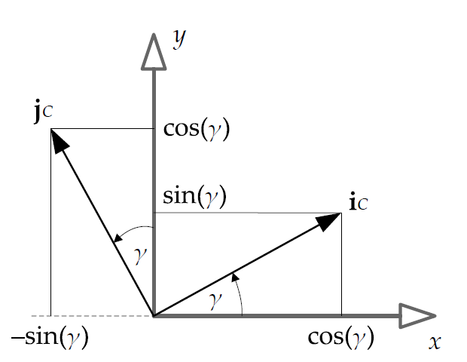
An example
Consider a child space rotating by $γ$around the z-axis
We can see that $i_{C}=\left[\begin{matrix}\cos{γ} & \sin{γ} & 0\end{matrix}\right]$ and
$$j_{C}=\left[−\begin{matrix}\sin{γ} & \cos{γ} & 0\end{matrix}\right]$$

Slide 54
Child to Parent
By putting these into our mapping equation with $k_{C}=\left[\begin{matrix}0 & 0 & 1\end{matrix}\right]$ we get
$$M_{C→P}=\left[\begin{matrix}\cos{γ} & \sin{γ} & 0 & 0 \\ −\sin{γ} & \cos{γ} & 0 & 0 \\ 0 & 0 & 1 & 0 \\ 0 & 0 & 0 & 1\end{matrix}\right]={rotate}_{z}\left(r,γ\right)$$

Slide 55
Extracting the basis
Given a 4 X 4 transformation matrix we can extract the unit basis vectors by grabbing the proper row
Say you have a vehicle’s model-to-world affine matrix and assume the vehicle always points in the positive z-axis
We can extract k_{c} from the transformation to get the vehicle facing direction

Slide 56
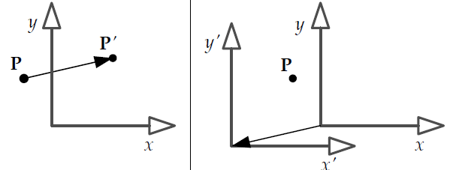
Confusion
You can transform a coordinate system as well as a point, but in the opposite direction
So, if a matrix transforms a point from child to parent space, then it also transforms coordinate axes from parent to child space

Slide 57
Transforming normal vectors
Remember a normal vector has to remain perpendicular to the surface it is associated with
In general if the point can be rotated from A to B with a 3X3 matrix $M_{A→B}$ then the normal vector will be transformed by ${\left(M_{A→B}^{−1}\right)}^{T}$
Its hard to prove, but true…

Slide 58
Quaternions
We can use a 3X3 matrix to represent a rotations
Not ideal
Nine floating point numbers for 3 DOF
Rotating a vector requires 9 multiplications and 6 additions
They are hard to interpolate
We can use a quaternion
$$q=\left[\begin{matrix}q_{x} & q_{y} & q_{z} & q_{w}\end{matrix}\right]$$

Slide 59
Quaternion
Developed by Sir William Rowan Hamilton in 1843
Used to solve problems in mechanics
The unit length quaternions can represent 3D rotations
All of them obey the constraint
$$q_{x}^{2}+q_{y}^{2}\text{+}q_{z}^{2}\text{+}q_{w}^{2}\text{=1}$$

Slide 60
Quaternion
Composed of two elements
A unit axis of rotation scaled by the sine of the half angle of rotation
The cosine of the half angle
Can also be written as a four element vector
, where

Slide 61
Operations
Magnitude and vector addition work the same
Adding two quaternions together is not the sum of two angles though
Multiplication is the most important operations – represents one rotation followed by another
$$pq=\left[\begin{matrix}\left(p_{S}q_{V}+q_{S}p_{V}+p_{V}{×q}_{V}\right) & \left(p_{S}q_{S}−p_{V}{⋅q}_{V}\right)\end{matrix}\right]$$

Slide 62
Conjugate and Inverse
The inverse of a quaternion q, denoted q⁻¹, has the following property
$$qq^{−1}=0i+0j+0k+1$$
To determine the inverse we need the conjugate
$$q^{∗}=\left[\begin{matrix}−q_{V} & q_{S}\end{matrix}\right]$$
The inverse then is
$$q^{−1}=\frac{q^{∗}}{{\left|q\right|}^{2}}$$

Slide 63
It’s simple
Remember our quaternions are all unit length this means
$$q^{−1}=q^{∗}=\left[\begin{matrix}−q_{V} & q_{S}\end{matrix}\right]$$
Other useful facts
$${(pq)}^{∗}=q^{∗}p^{∗}$$
$${(pq)}^{−1}=q^{−1}p^{−1}$$

Slide 64
Rotating with quaternions
To rotate a vector v by a quaternion q
We first write the vector in quaternion form
$$v=\left[\begin{matrix}v & 0\end{matrix}\right]=\left[\begin{matrix}v_{x} & v_{y} & v_{z} & 0\end{matrix}\right]$$
Then multiple q times v and by the inverse of q
$$v^{′}=rotate\left(q,v\right)=qvq^{−1}$$
or
$$v^{′}=rotate\left(q,v\right)=qvq^{∗}$$
Finally extract the vector out of $v^{′}=\left[\begin{matrix}v′ & 0\end{matrix}\right]$

Slide 65
Concatenation
For matrices we followed the rule
$$R_{net}=R_{1}R_{2}R_{3}$$
$$v^{′}=vR_{1}R_{2}R_{3}=vR_{net}$$
We do something similar with quaternion rotation
$$q_{net}=q_{3}q_{2}q_{1}$$
$$v^{′}=q_{3}q_{2}q_{1}vq_{1}^{−1}q_{2}^{−1}q_{3}^{−1}$$
$$=q_{net}vq_{net}^{−1}$$

Slide 66
Quaternion to matrix
If
$$q=\left[\begin{matrix}q_{V} & q_{s}\end{matrix}\right]=\left[\begin{matrix}q_{V_{x}} & q_{V_{y}} & q_{V_{z}} & q_{S}\end{matrix}\right]=\left[\begin{matrix}x & y & z & w\end{matrix}\right]$$
Then
$$R=\left[\begin{matrix}1−2y^{2}−2z^{2} & 2xy+2zw & 2xz−2yw \\ 2xy−2zw & 1−2x^{2}−2z^{2} & 2yz+2xw \\ 2xz+2yw & 2yz−2xw & 1−2x^{2}−2y^{2}\end{matrix}\right]$$
Much harder to go the other way

Slide 67
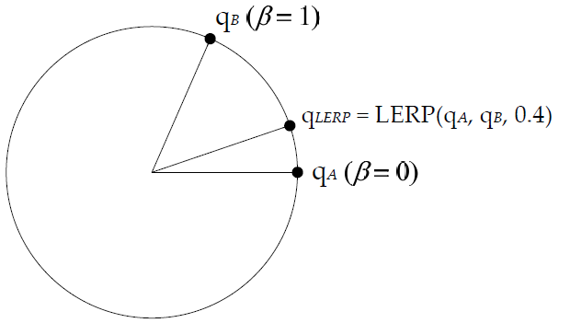
Rotational Interpolation
Given two quaternions q_{A} and q_{B} we can find an intermediate rotation β percent between them as
$$q_{LERP}=LERP\left(q_{A},q_{B},β\right)=\frac{\left(1−β\right)q_{A}+βq_{B}}{\left|\left(1−β\right)q_{A}+βq_{B}\right|}$$
$$=normalize\left({\left[\begin{matrix}\left(1−β\right)q_{A_{x}}+βq_{B_{x}} \\ \left(1−β\right)q_{A_{y}}+βq_{B_{y}} \\ \left(1−β\right)q_{A_{z}}+βq_{B_{z}} \\ \left(1−β\right)q_{A_{w}}+βq_{B_{w}}\end{matrix}\right]}^{T}\right)$$

Slide 68
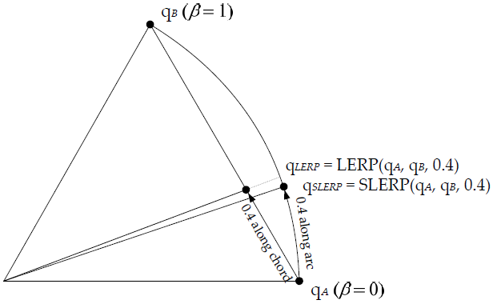
Problems with lerp
Because LERP interpolate along a chord instead of the actual surface of the 4D hyper-sphere, the angular speed is not constant
The beginning and end are slower than the middle

Slide 69
Slerp
Spherical Linear Interpolation (SLERP) fixes this
SLERP is like LERP, but the weighting of the two quaternions is modified based on the angle between them
where

Slide 70
Find the angle
To find the angle θ we use the following
$$\cos\left(θ\right)=p⋅q=p_{x}q_{x}+p_{y}q_{y}+p_{z}q_{z}+p_{w}q_{w}$$
$$θ=\cos^{−1}\left(p⋅q\right)$$

Slide 71
Should you slerp?
It depends
If you can get it to be fast enough, then use it
Otherwise LERP is fine and likely the user can’t tell anyway

Slide 72
Comparison of Rotational Representations
Euler Angles
Simple
Easy to visualize
Easy to interpolate unless it is around an arbitrary axis
Prone to gimbal lock
Order of the rotations matters
$$PYR≠YPR≠RYP$$

Slide 73
3X3 Matrix
Overall pretty good
Not subject to gimbal lock
Uses lots of computation and memory
Not very intuitive to read

Slide 74
Axis/Angle
We can use a representation similar to quaternions called axis+angle $\left[\begin{matrix}a & θ\end{matrix}\right]$
Easy to understand
Compact
Cannot interpolate rotations
Cannot be easily applied to points and vectors

Slide 75
Quaternions
Small
Can be easily applied to vectors and points
Easy to interpolate
Hard to read

Slide 76
SQT Transforms
Quaternions can only represent rotations
We can combine them with translation and scaling into a SQT transform
Good for most things
Easy to understand
Easy to interpolate
Compact representation
$$SQT=\left[\begin{matrix}s & q & t\end{matrix}\right]$$

Slide 77
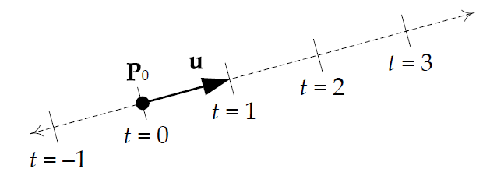
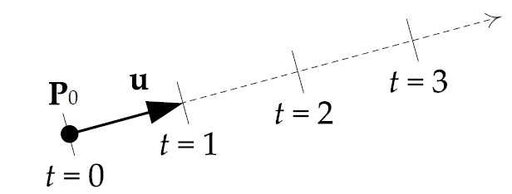
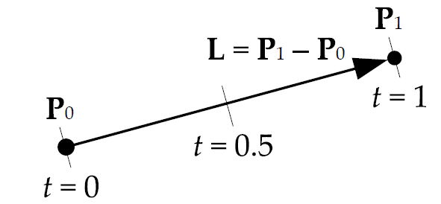
Other useful object
Line – can be represented using a parametric equation
$$P\left(t\right)=P_{0}+tu where −∞<t< +∞$$
Ray – only extends in one direction so t ≥ 0
Segment – bounded by two points 0 ≤t ≤ L

Slide 78
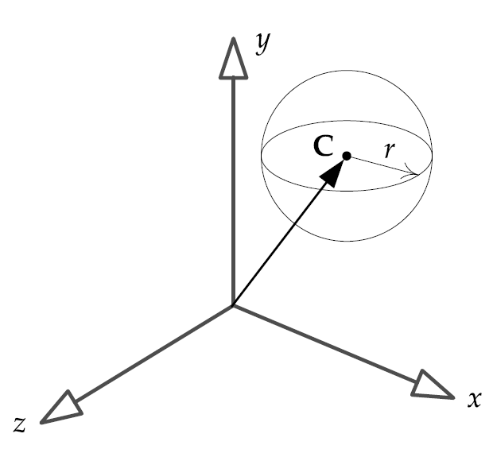
Spheres
Defined using a center point C and a radius r
Fits nicely in a 4 element vector

Slide 79
Planes
Plane is a 2D surface in 3D space
Only satisfied when P=[x y z] lies on the plane
$$Ax+By+Cz+D=0$$

Slide 80
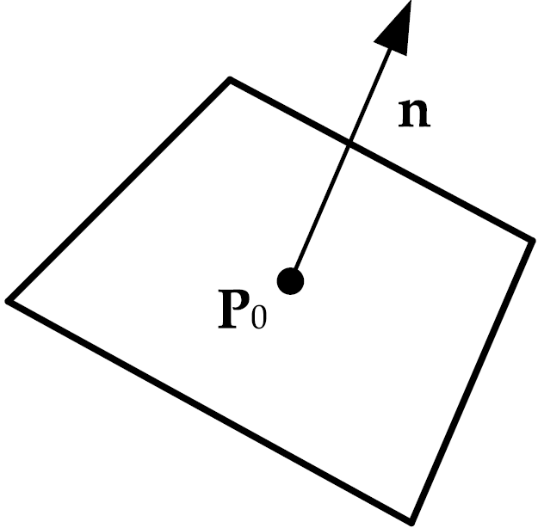
Point-normal
Planes can also be represented by
A point $P_{0}$
A unit vector n that is normal to the plane

Slide 81
Different, but the same
If A,B,C from the traditional equation are interpreted as a vector
The vector lies in the direction of the plane normal
The normalized version $[\begin{matrix}a & b & c]\end{matrix}=n$
The normalized parameter $d=D/{\sqrt{A^{2}+B^{2}+C^{2}}}$ is the distance to the origin

Slide 82
AABB
Axis aligned bounding box
Useful for collision detection
Represented using 6 values
$$\left[x_{min},x_{max},y_{min},y_{max},z_{min},z_{max}\right]$$
Or two points P_{min} and P_{max}
Easy to test if a point is within the bounds

Slide 83
oBB
Oriented bounding box
Differs from AABB because it aligns with the objects local coordinate space, not the world space
Testing for intersection usually involves transforming the point into the OBB coordinate system

Slide 84
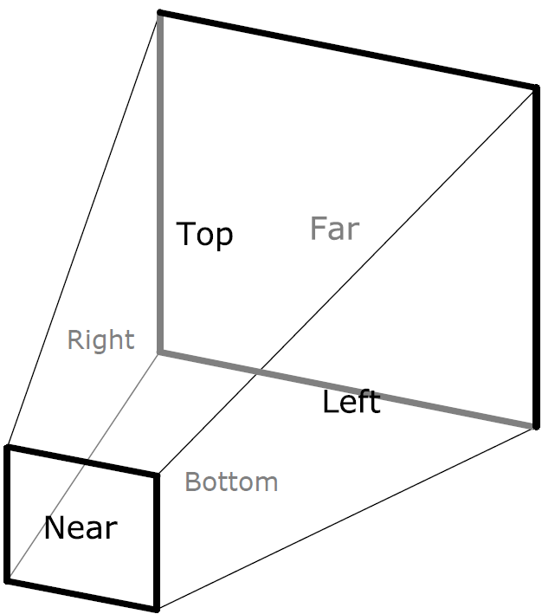
Frusta
A group of 6 planes that create a truncated pyramid shape
Usually represented as an array of six planes in point-normal form

Slide 85
Hardware-accelerated SIMD Math
Stands for Single Instruction Multiple Data
Allows a single operation to be performed on multiple data items in parallel
For example you can multiple four pairs of floating point numbers with a single command

Slide 86
History
Intel introduced MMX instruction in the first Pentiums
Could do SIMD on 8-eight bit, 4-16 bit or 2-32 bit integers
Later enhancements resulted in the Streaming SIMD Extensions (SSE)
Uses special 128-bit registers
Can perform parallel operation on 32-bit floating point numbers

Slide 87
SSE Registers
In packed 32-bit floating point mode holds 4 -32 floating point numbers
Elements are called $\left[\begin{matrix}x & y & z & w\end{matrix}\right]$
Consider the SIMD instruction
addps xmm0, xmm1
This performs the following operations
$$xmm0.x=xmm0.x+xmm1.x;$$
$$xmm0.y=xmm0.y+xmm1.y;$$
$$xmm0.z=xmm0.z+xmm1.z;$$
$$xmm0.w=xmm0.w+xmm1.w;$$

Slide 88
Using SIMD
Visual Studio has a special datatype __m128
Complier understands how to use it
__m128 v= _mm_set_ps(-1.0f, 2.0f, 0.5f, 1.0f);
GNU C/C++ uses the keyword vector
vector float = (vector float) (-1.0f, 2.0f, 0.5f, 1.0f);

Slide 89
Coding with SSE
Can use inline assembly
__m128 addWithAssembly(const __m128 a, const __m128 b)
{
__asm addps xmm0, xmm1
}
Can use intrinsics (# include <xmmintrin.h>)
__m128 addWithIntrinsics(const __m128 a, const __m128 b)
{
return _mm_add_ps (a,b);
}

Slide 90
Vector-matrix multiplication
Say you want to multiple a 1X4 vector v with a 4X4 matrix M to get the solution r
$$r=vM$$
$$\left[\begin{matrix}r_{x} & r_{y} & r_{z} & r_{w}\end{matrix}\right]=\left[\begin{matrix}v_{x} & v_{y} & v_{z} & v_{w}\end{matrix}\right]\left[\begin{matrix}M_{11} & M_{12} & M_{13} & M_{14} \\ M_{21} & M_{22} & M_{23} & M_{24} \\ M_{31} & M_{32} & M_{33} & M_{34} \\ M_{41} & M_{42} & M_{43} & M_{44}\end{matrix}\right]$$
=$\left[\begin{matrix}{v_{x}M}_{11}+{v_{y}M}_{21}+{v_{z}M}_{31}+{v_{w}M}_{41} \\ {v_{x}M}_{12}+{v_{y}M}_{22}+{v_{z}M}_{32}+{v_{w}M}_{42} \\ {v_{x}M}_{13}+{v_{y}M}_{23}+{v_{z}M}_{33}+{v_{w}M}_{43} \\ {v_{x}M}_{14}+{v_{y}M}_{24}+{v_{z}M}_{34}+{v_{w}M}_{44}\end{matrix}\right]$

Slide 91
Attempt 1
We could store v in an SSE and each column of M in an SSE
The multiple each M SSE by the v SSE
We get
$$vMcol1= \left[\begin{matrix}{v_{x}M}_{11} & {v_{y}M}_{21} & {v_{z}M}_{31} & {v_{w}M}_{41}\end{matrix}\right];$$
$$vMcol2= \left[\begin{matrix}{v_{x}M}_{12} & {v_{y}M}_{22} & {v_{z}M}_{32} & {v_{w}M}_{42}\end{matrix}\right];$$
$$vMcol3= \left[\begin{matrix}{v_{x}M}_{13} & {v_{y}M}_{23} & {v_{z}M}_{33} & {v_{w}M}_{43}\end{matrix}\right];$$
$$vMcol4= \left[\begin{matrix}{v_{x}M}_{14} & {v_{y}M}_{24} & {v_{z}M}_{34} & {v_{w}M}_{44}\end{matrix}\right];$$
Now we have to add across the vectors
Not very fast

Slide 92
Attempt 2
We could create SSEs with replicated values from v and multiple each row of M by the appropriate v SSE
We get
Now we can add the vectors
Much better

Slide 93
Random Number Generator
Linear Congruent Generators
Found in the c rand() function
Not particular good
Mersenne Twister
Very large period (before repeating a sequence)
Very high order of equidistribution
Passes numerous test for randomness
Fast
Mother-of-All
Published by George Marsaglia
Reasonable period
Faster than Mersenne Twister

