Slide 1

Game Engine Architecture
Chapter 5
Engine Support Systems

Slide 2
Overview
Subsystem Start-up and shut down
Memory Management
Containers
Strings
Engine Configuration

Slide 3
Start-up and shut-down
Game engines are complex beasts
When it first starts up a number of subsystems must be configured and initialized
Order is relevant because of subsystem dependencies
Typically started in one direction and shutdown in the opposite

Slide 4
Singleton
A common pattern for game engine components is to create managers using a singleton
class RenderManager{
public:
  RenderManager (){
    //start up the manager
  }
  ~RenderManager (){
    //shut down the manager
  }
};
//singleton instance
static RenderManager gRenderManager

Slide 5
Initialization and singleton
C++ does static object creation just before the main method is called
The order for static object creation is arbitrary
Not very good for controlling the order of startup and shutdown

Slide 6
Controlling the singleton
One trick you can use is that a static variable declared within a method is not initialized at startup
class RenderManager{
public:
static RenderManager& get(){
static RenderManager sSingleton;
return sSingleton;
}
  RenderManager (){
  VideoManager::get();
  TextureManager::get();
  }
  ~RenderManager (){
    //shut down the manager
  }
};
This works pretty well, but you cannot control the shutdown at all

Slide 7
Do it directly
Create startup and shutdown methods in all of the managers
  It’s simple
  It’s understandable
  Easy to debug and maintain
You could also use singletons where the main creates the objects using new
Take a look at the code from OGRE and Naughty Dog’s games in the book

Slide 8
Memory Management
The performance of your game engine is associated not only with your algorithms, but the way you use memory
  malloc() and new are slow
  Access pattern and memory fragmentation seriously impact caching performance

Slide 9
Dynamic Allocation
Heap allocation is slow because it has to be general
  Handles requests from 1 byte to 1GB
  Creates a ton of management overhead
Also slow because of a context switch
  First switches from user to kernel mode
  Then has to switch back
Cannot completely avoid dynamic allocation, but can create custom allocators to avoid it

Slide 10
Stack-based Allocator
The easiest way is to use a pre-allocated memory block and use it as a stack
When a level is loaded, add it to the stack, when it is finished, move the stack pointer back
Order is important because you can overwrite a current used memory location
Often done using rollback markers

Slide 11
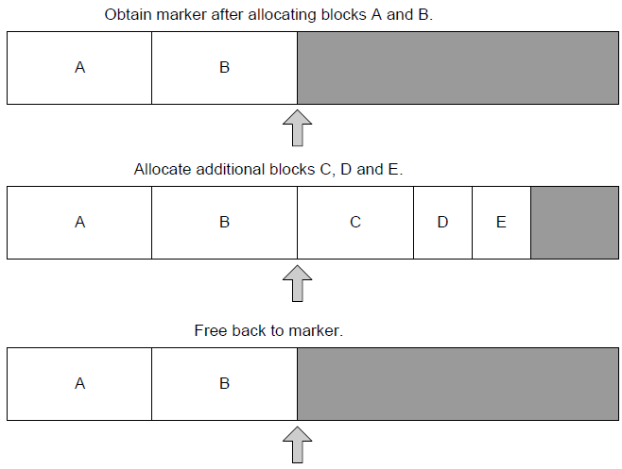
Stacks

Slide 12

Double ended
Another method uses a double ended stack
  Useful for having big allocations on one side and small temporary on the other

Slide 13
Pool Allocator
This technique works by allocating a large number of fixed sized memory blocks
  1,000 4X4 matrices
When you need a new matrix, you get it from the pool
Return it to the pool when are done
The pool can be managed by a linked list

Slide 14
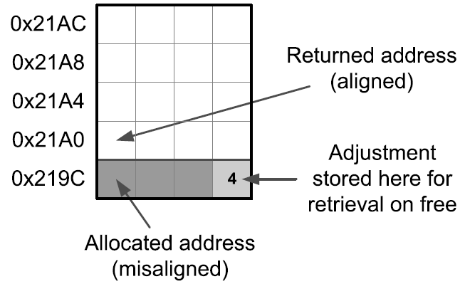
Aligned Allocation
One problem with pooled memory is that every variable and object has an alignment requirement
The memory allocator must be able to return aligned memory otherwise you have serious trouble
Not a serious problem as an aligned allocator is easy to write

Slide 15
Single or double frame
You often need to allocate memory every frame One way to do this is to use a single frame buffer
Allocate the memory once and free it only when the rendering is complete
  Very fast, you have to be careful
A double frame buffer might be better in a multi-core setup
  Allocate memory at frame i for use in i+1

Slide 16


Fragmentation
Doing dynamic allocation can create memory fragments
  This slows down memory copies
  Can prevent allocation when a contiguous block is not available
Pooled and stack allocators avoid this problem

Slide 17
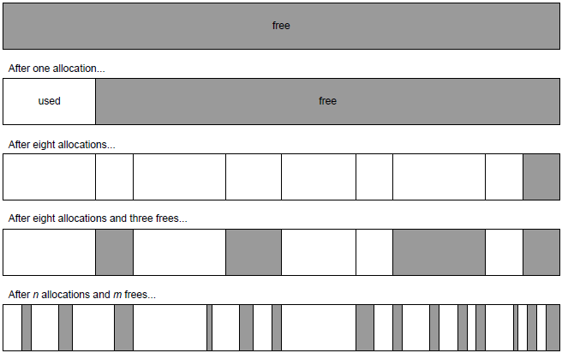
Fragmentation
If you need random allocation/deallocation you may require a defragmentation routine

Slide 18
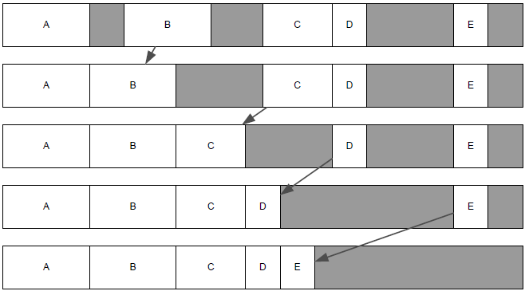
Shift

Slide 19
Defrag
The defrag operation can occur over several frames
  Just move one thing at a time
Moving memory is tricky though
  All pointers to it need to be updated
Handles are frequently used
  Handles point to immutable memory that contains the current pointer to the object (yes, a pointer to a pointer)

Slide 20
Cache
By now, you should understand how cache works
To avoid cache misses on data, we try to keep data chunks small, contiguous in memory, and access them sequentially
Instructions are also held in cache

Slide 21
I-Cache
The compiler and linker handle most of the details about how code is represented in memory
We can help it because it follows certain rules
  Machine code from a function is contiguous in memory
  Functions are stored in their original order
  Functions in a single file are almost always contiguous

Slide 22
Taking Advantage
Keep high-performance code small
Avoid making function calls in a performance critical section
If you have to call a function, put it as close as possible to the caller and never in another file
Don’t overuse inline functions, they can bloat the code

Slide 23
Containers
Games developers use many different data structures
  Array
  Dynamic Array
  Linked List
  Queue
  Deque
  Tree
  Binary Search Tree
  Binary heap
  Priority Queue
  Dictionary
  Set
  Graph
  Directed acyclic graph
Many of these can be found in STL (Standard Template Library)

Slide 24
Container Operations
Insert
Remove
Sequential access (iteration)
Random access
Find
Sort
Remember that different containers have different costs for these various operations

Slide 25
Iterators
STL has an iterator class that works much like the one in Java
Allows you to maintain encapsulation in the container object
Easier to use than pointer manipulation
  void processList (std::list<int>& container)
  {
  std::list<int>::iterator pBegin = container.begin();
  std::list<int>::iterator pEnd = container.end();
  std::list<int>::iterator p;
  for (p = pBegin; p !=pEnd; p++)
  {
  int element = *p;
  }
  }

Slide 26
Building Custom Containers
Many reasons to do so
Total control – you dictate the algorithms, memory use, etc.
Opportunities to optimize – optimize based on a specific hardware platform
Customizability – can add custom features specific to your purpose
Elimination of external dependencies – no licensing fees, you can fix it yourself
Control of concurrent data structures – you have total control over concurrent access

Slide 27
Standard Template Library
Benefits
  Rich set of features
  Robust implementation on a wide variety of platforms
  Comes standard with most C++ compilers
Drawbacks
  Steep learning curve
  Often slower than a custom crafted data structure
  Eats up a lot of memory
  Does a lot of dynamic memory allocation
  Performance varies based on the compiler

Slide 28
Rules for using STL
Be aware of the performance and memory characteristics
Avoid heavyweight STL classes in critical code sections
Don’t use it when memory is at a premium
Use STLPort if you plan to create multiplatform games

Slide 29
Boost
Aim was to build libraries that extend and work with STL
Benefits
  Provides things not available in STL
  Provides some workarounds to problems with STL
  Handles complex problems like smart pointers
  Documentation is really good
Drawbacks
  Most core classes are templates – has large .lib files
  No guarantees – if you find a bug, it’s your issue
  Boost license – not very restrictive

Slide 30
Loki
Written by Andrei Alexandrescu
Very powerful, but hard to understand
Less portable because it uses sophisticated compiler tricks
Look for the book Modern C++ Design by Alexandrescu

Slide 31
Strings
Strings are extremely important in games
They are far from simple to manage
  What if they need to be resized?
  How do you deal with localization issues?
    Different character sets
    Different lengths for translations
    Different display layouts
Checking for equality is an O(n) operation

Slide 32
String Classes
They come with an overhead
  Copy constructors on a function call
  Dynamic memory allocation
Probably should be avoided by using fixed sized wchar_t arrays
Path classes might be the exception
  Often include more information than a String

Slide 33
Unique IDs
Objects within the game need a way to be identified
Strings seem like a natural choice
  Comparison costs are not good
GUIDs (numbers) are a lot faster to compare
  Harder to remember

Slide 34
Hashed String IDs
We can use hash functions to map our strings to numbers
  Best of both worlds
Collisions are possible
  A good hash function eliminates this concern
  Using an uint32 for the values gives over 4 million possible values
These are sometimes referred to as a string id

Slide 35
Implementation ideas
Runtime hashing can be slow
  Doing many of them can take a long time
One way to avoid this is to offline process the source code
  Look for occurrences of the function call and replace it with the hashed number
Another way is to create a static variable to intern the string ids

Slide 36
Localization
Best to plan for localization from day 1
Important to understand that ASCII character codes don’t support localization at all
Retrain your brain to think in Unicode

Slide 37
Unicode
Like ASCII, unicode assigns a unique code point to every character or glyph
When storing characters we use a particular encoding
The combination of encoding and code point yields a character or glyph
Common encodings are
  UTF-32
  UTF-8
  UTF-16

Slide 38
UTF-32
The simplest encoding because all code points are stored in a 32-bit value
Wasteful
  Most western languages don’t use high value code points (wastes 2 bytes per character)
  The highest Unicode code point is 0x10FFFF (only 21 bits)
Easy because we can figure out the length of a string by dividing number of bytes by 4

Slide 39
UTF-8
Code points are stored in one-byte granularity, but some use two
It’s called variable length encoding or multibyte character set (MBCS)
It’s backwards compatible with ANSI encoding
  Needs 7 bits to represent the 127 characters
Multibyte characters have the first bit set to one
  This indicates that there are two bytes in the code point

Slide 40
UTF-16
A bit simpler than UTF-8, but more expensive
Code points stored as one or two 16-bit values
Also called Wide Character Set (WCS)
UTF contains 17 planes that each contain 2¹⁶ code points
First plane called basic multilingual plane (BMP)
  Most characters are present in this plane
The other planes are called supplementary planes
  Requires two 16-bit values

Slide 41
UCS-2
A subset of UTF-16 containing only the BMP
Its main advantage is that it is fixed length
  UTF-16 and UTF-8 are variable length
Can be stored in little endian or big endian
  Often stored with a Byte Order Marker (BOM)

Slide 42
char and wchar_t
Standard C/C++ define two data types for characters
  char is used to for legacy ANSI strings or for MBCS
  wchar_t is used to represent any valid code point
    Could be 8, 16, or 32 bits
To write truly platform independent code you will need to define your own character data types

Slide 43
Unicode in Windows
In Windows wchar_t is exclusively for UTF-16 encoding and char for ANSI encoding
Windows API defines three sets of character/string functions
There are also translation functions like wcstombs()
ANSI | WCS | MBCS
strcmp() | wcscmp() | _mbscmp()
strcpy() | wcscpy() | _mbscpy()
strlen() | wcslen() | _mbstrlen()

Slide 44
Unicode on Consoles
Xbox360 uses WCS strings
At Naughty Dog they only use char strings
  Foreign languages are handled with UTF-8 encoding

Slide 45
Other Localization Concerns
Need to translate more than strings
  Audio clips
  Textures – if they have English words on them
  Symbols – may not mean what you think it means
  Market specific game-rating issues – blood changes the teen-rating in Japan
Localization database
  Need a way to convert string ids to human readable strings
  Form is up to you – Varies from CSV to full databases
Id | English | French
p1score | “Player 1 Score” | “Grade Joueur 1”
p2score | “Player 2 Score” | “Grade Joueur 2”
p1wins | “Player one wins!” | “Joueur un gagne!”
p2wins | “Player two wins!” | “Joueur deux gagne!”

Slide 46
Final notes
Establish a set of functions early to handle localization
Force developers to use those functions instead of using string literals in the code
Create a configuration system to allow the language to be set

Slide 47
Engine Configuration
Most engines require the ability to save and load configuration files
Many ways to do this
  Text files
  Compressed binary files
  Windows registry
  Command line options
  Environmental variables
  Online user profiles

Slide 48
Game vs User options
Be careful to separate the game settings from those of a particular user
On windows machines you can use ApplicationData directory by creating your own folder
You can also use the special key HKEY_CURRENT_USER in the registry to store settings information

Slide 49
Examples
Quake uses Cvars – named values with a set of flags
  These are stored in a linked list and the values are retrieved by name
  The flags indicate if the value should persist – written to file
Ogre3D
  Uses text files in the Windows INI format
Uncharted
  Several mechanisms including Scheme

