Slide 1
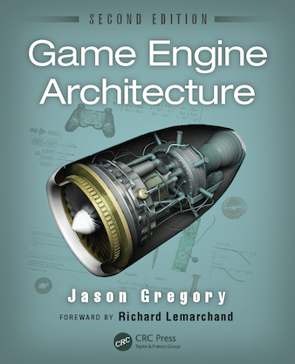
Game Engine Architecture
Chapter 6
Resources and the File System

Slide 2
Overview
File System
Resource Manager

Slide 3
Data
Game engines are inherently data management systems
Handle all forms of input media
Textures
3D mesh data
Animations
Audio clips
World layouts
Physics data
Memory is limited, so we need to manage these resources intelligently

Slide 4
File system
Resource managers make heavy use of the file system
Often the file system calls are wrapped
Provides device independence
Provides additional features like file streaming
Sometimes the calls for accessing different forms of media are distinct - Disk versus a memory card on a console
Wrapping can remove this consideration

Slide 5
Engine file system
Game engine file systems usually address the following issues
Manipulating filenames and path
Opening, closing, reading and writing individual files
Scanning the contents of a directory
Handling asynchronous file I/O requests

Slide 6
File names and paths
Path is a string describing the location of a file or directory
volume/directory1/directory2/…/directoryN/file-name
They consist of an optional volume specifier followed by path components separated with a reserved character (/ or \)
The root is indicated by a path starting with a volume specifier followed by a single path separator

Slide 7
OS differences
UNIX and Mac OS X
Uses forward slash (/)
Supports current working directory, but only one
Mac OS 8 and 9
Uses the colon (:)
Windows
Uses back slash (\) – more recent versions can use either
Volumes are specified either as C: or \\some-computer\some-share
Supports current working directory per volume and current working volume
Consoles – often used predefined names for different volumes

Slide 8
Pathing
Both windows and UNIX support absolute and relative pathing
Absolute
Windows - C:\Windows\System32
Unix - /usr/local/bin/grep
Relative
Windows – system32 (relative to CWD of c:\Windows)
Windows – X:animation\walk\anim (relative to CWD on the X volume)
Unix – bin/grep (relative to CWD of /usr/local)

Slide 9
Search path
Don’t confuse path with search path
Path refers to a single file
Search path is multiple locations separated by a special character
Search paths are used when trying to locate a file by name only
OGRE uses a file called resources.cfg that contains a list of directories and zip files to look through
Avoid searching for a file as much as possible – it’s costly

Slide 10
Path API
Windows offers an API for dealing with paths and converting them from absolute to relative
Called shlwapi.dll
Playstation 3 and 4 have something similar
Often better to build your own stripped down version

Slide 11
Basic file i/o
Standard C library has two APIs for file I/O
Buffered
Manages its own data buffers
Acts like streaming bytes of data
Unbuffered
You manage your own buffers

Slide 12
File operations
Operation | Buffered API | Unbuffered API
Open a file | fopen() | open()
Close a file | fclose() | close()
Read from a file | fread() | read()
Write to a file | fwrite() | write()
Seek an offset | fseek() | seek()
Return current offset | ftell() | tell()
Read a line | fgets() | n/a
Write a line | fputs() | n/a
Read formatted string | fscanf() | n/a
Write a formatted string | fprintf() | n/a
Query file status | fstat() | stat()

Slide 13
File system specific
On UNIX system, the unbuffered operations are native system calls
On Windows, there is even a lower level
Some people wrap these calls instead of the standard C ones
Some programmers like to handle their own buffering
Gives more control to when data is going to be written

Slide 14
To wrap or not
Three advantages to wrapping
Guarantee identical behavior across all platforms
The API can be simplified down to only what is required
Extended functionality can be provided
Disadvantages
You have to write the code
Still impossible to prevent people from working around your API

Slide 15
Synchronous file i/o
The standard C file I/O functions are all synchronous
bool syncReadFile(const char* filePath, U8* buffer, size_t bufferSize, size_t& rBytesRead){
FILE* handle = fopen(filePath, “rb”);
if(handle){
size_t bytesRead = fread(buffer, 1, bufferSize, handle); //blocks until all bytes are read
int err = ferror(handle);
fclose(handle);
if(0==err){
rBytesRead = bytesRead;
return true;
}
}
return false;
}

Slide 16
Asynchronous I/O
Often it is better to make a read call and set a callback function when data become available
This involves spawning a thread to manage the reading, buffering, and notification
Some APIs allow the programmer to ask for estimates of the operations durations
They also allow external control

Slide 17
Priorities
It is important to remember that certain data is more important than others
If you are streaming audio or video then you cannot lag
You should assign priorities to the operations and allow lower priority ones to be suspended

Slide 18
Best practices
Asynchronous file I/O should operate in its own thread
When the main thread requests an operation, the request is placed on a queue (could be priority queue)
The file I/O handles one request at a time

Slide 19
Resource manager
All good game engine have a resource manager
Every resource manager has two components
Offline tools for integrating resource into engine ready form
Runtime resource management

Slide 20
Off-line resource management
Revision control - can be managed using a shared drive or a complex system like SVN or Perforce
Cautions about data size
Remember that code is small compared to images or video
May not want many copies lying around (they all need to be backed up)
Some places deal with this by using symlinking

Slide 21
Resource database
The resource database contains information about how an asset needs to be conditioned to be useful in a game
For example, an image may need to be flipped along its x-axis, some images should be scaled down
This is particularly true when many people are adding assets

Slide 22
Resource data
The ability to deal with multiple types of resources
The ability to create new resources
The ability to delete resources
The ability to inspect and modify resources
The ability to move the resources source file to another location
The ability for a resource to cross-reference another resource
The ability to maintain referential integrity
The ability to maintain revision history
Searches and queries

Slide 23
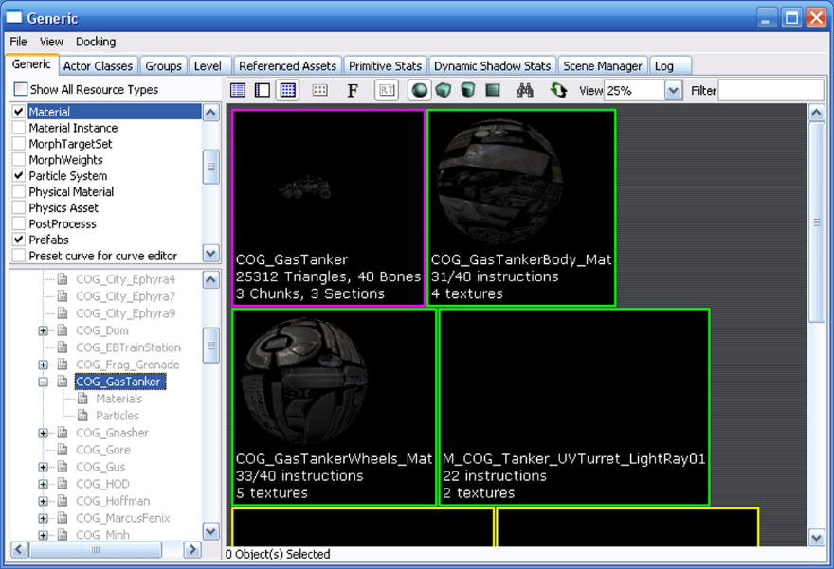
Some successful designs
UT4
All managed using UnrealEd
Has some serious advantages, but is subject to problems during multiple simultaneous updates
Stores everything in large binary files – impossible for SVN

Slide 24
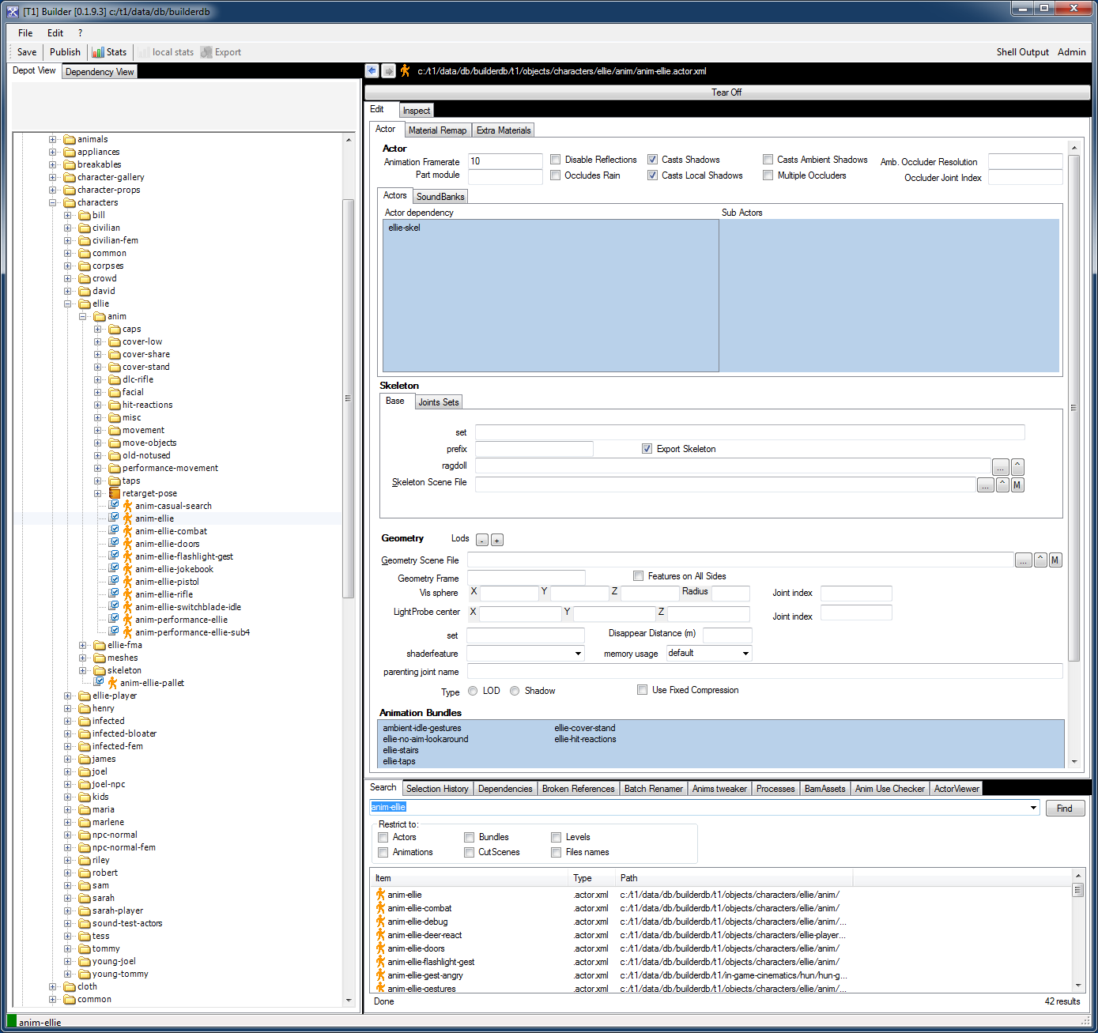
Another example
Uncharted/Last of Us
Uses a MySQL database – later changed to XML using Perforce
Asset conditioning done using offline command prompt tools

Slide 25
Still others…
Ogre
Runtime only resource management
XNA
A plugin to VS IDE called Game Studio Express

Slide 26
Asset conditioning
Assets are produced from many source file types
They need to be converted to a single format for ease of management
There are three processing stages
Exporters – These get the data out into a useful format
Resource compilers – pre-calculation can done on the files to make them easier to use
Resource linker – multiple assets can be brought together in one file

Slide 27
Resource dependencies
You have to be careful to manage the interdependencies in a game
Assets often rely on one another and that needs to be documented
Documentation can take written form or automated into a script
make is a good tool for explicitly specifying the dependencies

Slide 28
Runtime resource management
Ensure that only one copy of an asset is in memory
Manages the lifetime of the object
Handles loading of composite resources
Maintains referential integrity
Manages memory usage
Permits custom processing
Provides a unified interface
Handles streaming

Slide 29
Resource files
Games can manage assets by placing them loosely in directory structures
Or use a zip file (Better)
Open format
Virtual file remember their relative position
They may be compressed
They are modular
UT3 uses a proprietary format called pak (for package)

Slide 30
Resource file formats
Assets of the same type may come in many formats
Think images (BMP, TIFF, GIF, PNG…)
Some conditioning pipelines standardize the set
Other make up there own container formats
Having your unique format makes it easier to control the layout in memory

Slide 31
Resource guids
You will need a way to uniquely identify assets in your game
Come up with a naming scheme
Often involves more than just the file path and name
In UT files are named using
package.folder.file

Slide 32
Resource registry
In order to only have an asset loaded once, you have to have a registry
Usually done as a giant hashmap (keyed on GUID)
Resources loading can be done on the fly, but that is usually a bad idea
Done in-between levels
In the background

Slide 33
Resource lifetime
Some resources are LSR (load-and-stay resident)
Character mesh
HUD
Core Animations
Some are level specific
Some are very temporary – a cut-scene in a level
Other are streaming
Lifetime is often defined by use, sometimes by reference counting

Slide 34
Memory management
Very closely tied to general memory management
Heap allocation – allow the OS to handle it
Like malloc() or new
Works fine on a PC, not so much on a memory limited console
Stack allocation
Can be used if
The game is linear and level centric
Each level fits in memory

Slide 35
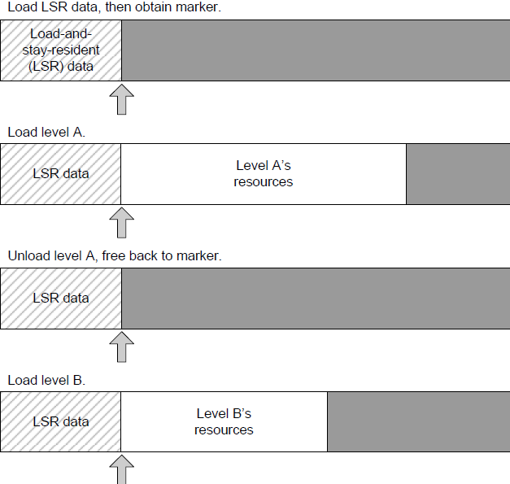
Stack allocation

Slide 36
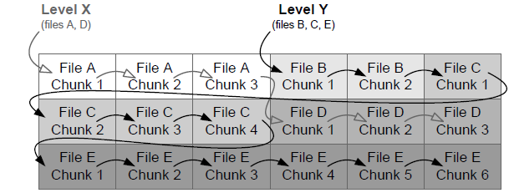
Pool allocation
Load the data in equal size chunks
Requires resource to be laid out to permit chunking
Each chunk is associated with a level

Slide 37
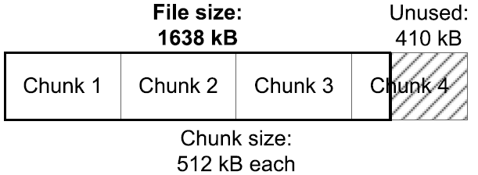
Pool allocation
Chunks can be wasteful
Choose the chunk size carefully
Consider using the OS I/O buffer size as a guide

Slide 38
Resource chunk allocator
You can reclaim unused areas of chunks
Use a linked list of all chunks with unused memory along with the size
Works great if the original chunk owner doesn’t free it
Can be mitigated by considering lifetimes
Only allocated unused parts to short lifetime objects

Slide 39
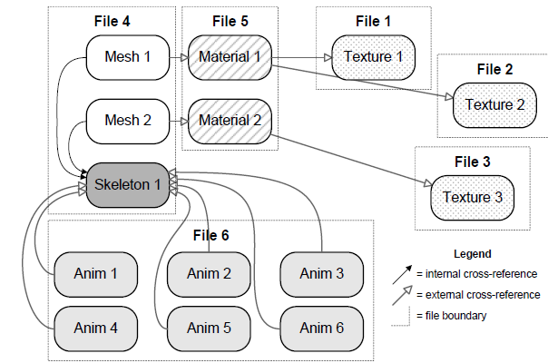
Composite resources
Resource database contains multiple resource files each with one or more data objects
Data objects can cross-reference each other in arbitrary ways
This can be represented as a directed graph

Slide 40
Composite resources
A cluster of interdependent resources is referred to as a composite resource
For example, a model consists of
One or more triangle meshes
Optional skeleton
Optional animations
Each mesh is mapped with a material
Each material refers to one or more textures

Slide 41
Handling cross-references
Have to ensure that referential integrity is maintained
Can’t rely on a pointer because they are meaningless in a file
One approach is to use GUIDs
When a resource is loaded the GUID is stored in a hashmap along with a reference to it

Slide 42
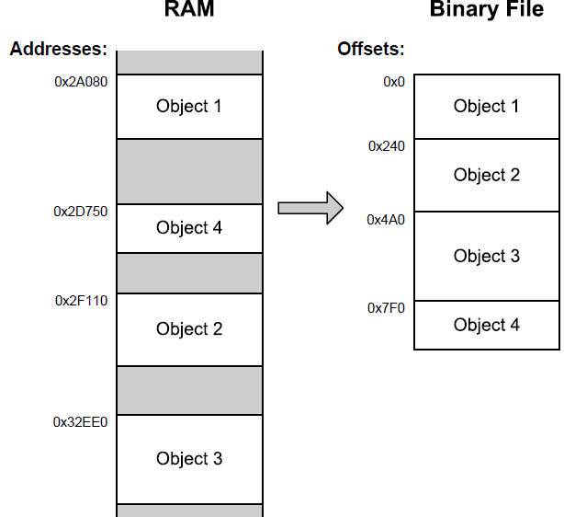
Pointer fix-up tables
Another approach is to convert pointers to file offsets

Slide 43
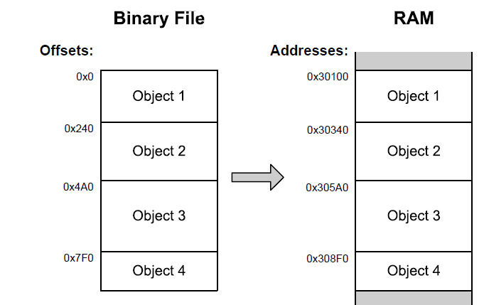
Pointer fix-up tables
During file writing all references are converted from pointers to the offset location in the file
Works because offsets are smaller than pointers
During reading, we convert offsets back to pointers
Known are pointer fix-ups
Easy to do because now the file is contiguous in memory

Slide 44
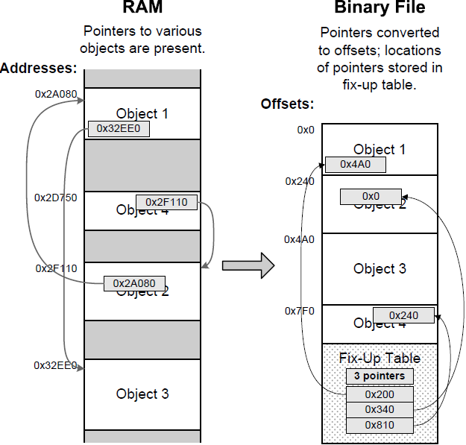
Pointer fix-up tables
Also need to remember the location of all pointers that need fixing
This is done by creating a table during file writing
Known as a pointer fix-up table

Slide 45
Constructors
When dealing with storing C++ objects make sure you call the object constructors
You can save the location of the objects and use placement new syntax to call the constructor
void* pObject = convertOffsetToPointer(objectOffser, pAddressOfFileImage);
::new(pObject) ClassName;

Slide 46
Handling external references
Externally referenced objects have to be handled differently
Store the path along with the GUID or offset
Load each file first then fix the references in a second pass

Slide 47
Post-load initialization
Cannot always load in a ready-to-go state
Unavoidable – need to move vertex data to the video card
Avoidable, but convenient – calculating spline data during development
In C++ using virtual functions like init() and destroy() may be the simplest strategy

