Slide 1
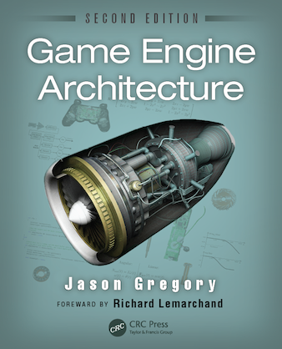
Game Engine Architecture
Chapter 7
The Game Loop and Real-Time Simulation

Slide 2
Overview
Rendering Loop
The Game loop
Game Loop Architectural Styles
Abstract Timelines
Multiprocessor Game Loops

Slide 3
Rendering Loop
In the early days of games, video cards were really slow
  If they actually had a card
Programmers optimized rendering using
  Specialized hardware – allowed fixed number of sprites to be overlaid
  XOR operations
  Copy a portion of the background, drawing the sprite and later restoring the background
Today, when the camera moves the entire scene changes
  Everything is invalidated
  It is faster to redraw everything than trying to figure out what to redraw

Slide 4
Simple loop
while(!quit){
  updateCamera();
  updateSceneElements();
  renderScene();
  swapBuffers();
}

Slide 5
Game Loop
Games have many subsystems that interact
These systems need to update at different rates
  Physics – 30,60, or up to 120Hz
  Rendering – 30-60Hz
  AI – 0.5 – 1 Hz
Lots of ways to do variable updating
Let’s consider a simple loop

Slide 6
Pong
Started as Tennis for Two in 1958
  William A Higinbotham at Brookhaven National Labs
Later turned into Table Tennis on the Magnavox Odyssey
Then became Atari Pong

Slide 7
Pong game loop
void main(){
  initGame();
  while(true){
    readHumanInterfaceDevices();
    If (quitButtonPressed())
      break;
    movePaddles();
    moveBall();
    collideAndBounceBall();
    handleOutOfBounds();
    renderPlayfield();
  }
}

Slide 8
Game loop styles
Windows message pump
while(true){
  MSG msg;
  while(PeekMessage(&msg, NULL, 0, 0) > 0){
    TranslateMessage(&msg);
    DispatchMessage(&msg);
  }
  RunOneIterationOfGameLoop();
}
Messages take precedence – everything else pauses

Slide 9
Callback-driven
Within a game framework, the main loop is provided – largely empty
Developer builds a class that implements a frameListener that is called before and after the scene is rendered

Slide 10
Call back loop
while(true){
  for (each frameListener)
    framelistener.frameStarted();
  renderCurrentScene();
  for (each frameListener)
    framelistener.frameEnded();
    finalizeSceneAndSwapBuffers();
}

Slide 11
Frame listener
class GameFrameListener : public Ogre::FrameListener{
public:
  virtual void frameStarted(const FrameEvent& event){
    pollJoypad(event);
    updatePlayerControles(event);
    //etc…
  }
  virtual void frameEnded(const FrameEvent& event){
    updateHUD(event);
    //etc…
  }
};

Slide 12
Event-based updating
Another way to design the loop is to use an event system
Works like a frame listener, but uses an event bus for the components to speak with one another

Slide 13
Abstract timelines
Real time – measure by the CPU high resolution timer
Game time – mostly controlled by real-time, but can be slowed, sped up, or paused
Local and global time – animations have their own timeline. We can map it to global time in any way we want (translation, scaling)

Slide 14
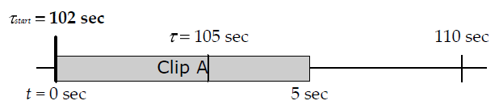
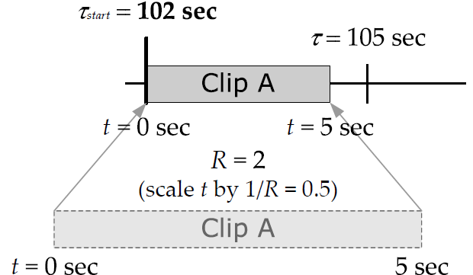
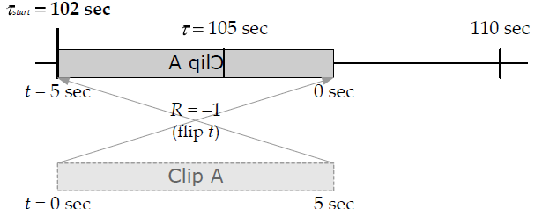
Mapping time
Simple Mapping
Scaled Mapping
Reverse Mapping

Slide 15
Measuring time
By now we understand the concept of FPS. This also leads to the idea of deltaTime (the time between frames)
We can use deltaTime to update the motion of objects in the game to keep the perception of time constant despite the frame rate (only if we are measuring it)

Slide 16
Old school
Early games did not measure the amount of real time that elapsed
Game objects were moved a fixed amount per iteration
  Movement rate of the objects were dependent on the CPU speed
Sucked when you upgraded the computer because the game ran too fast to play
The turbo button was used to solve this problem in some cases
  Turn off turbo to slow the computer down and make an older game playable

Slide 17
Thinking about time
One method that is often used is to read time directly and compute deltaTime
Has some problems
  We use this frame’s time as an estimate of next frames time
  Can lead to cascade delays and instability
We could use a running average
  Smoothes things out a bit
  Long averages smooth out time, but are less reactive

Slide 18
Govern the rate
It is best to govern the rate by sleeping between frames in order to standardize the time
Need to have fairly consistent frame rates
Has the advantage that everything is consistent
Also easier to make a record and playback function

Slide 19
Blanking
Many games govern their frame rate to the v-blank interval
This prevents tearing and limits the repaints to the maximum possible updating of the screen
  Why render frames that never get displayed

Slide 20
Measuring time
All modern processors have a special register that holds a clock tick count since power on
These can be super high resolution because the clock can tick 3 billion times per second
Most of these registers are 64-bit so hold 1.8X10¹⁹ ticks before wrapping – 195 years on a 3.0 GHz processor

Slide 21
Accessing time
Different CPUs have different ways to get time
Pentiums use rdtsc (real time-stamp counter)
  Wrapped in Windows with QueryPerformanceCounter()
On PowerPC (Xbox 360 or Playstation 3) use mftb (move from time base register)
On other PowerPCs use mfspr (move from special-purpose register)

Slide 22
Multi-cores
These clocks can drift so take caution
On multi-core processors all of the clocks are independent of one another
Try not to compare the times because you will get strange results

Slide 23
Time units
You should standardize time units in your engines and decide on the correct data type for the storage
  64-bit integer clock
  32-bit integer clock
  32-bit floating point clock

Slide 24
64-bit integer clock
Worth it if you can afford the storage
Direct copy of the register in most machines so no conversion
Most flexible time representation

Slide 25
32-bit integer clock
Often we can use a 32-bit integer clock to measure short duration events
  U64 begin_ticks = readHiResTimer();
  doSomething();
  U64 end_ticks = readHiResTimer();
  U32 dt_ticks = static_cast<U32>(end_ticks – begin_ticks);
Careful because it wraps after just 1.4 seconds

Slide 26
32-bit floating point
Another common approach is to store small values in a 32-bit float in units of seconds
  U64 begin_ticks = readHiResTimer();
  doSomething();
  U64 end_ticks = readHiResTimer();
  F32 dt_seconds = (F32) (end_ticks – begin_ticks) / (F32) getHiResTimerFreq();
Subtract the two U64s before the cast to prevent overflow

Slide 27
About floats
Keep in mind that precision and magnitude are inversely related for floats
  As the exponent increases the fraction space decreases
Reset the float every once in a while to avoid decreased precision

Slide 28
Other time units
Some game engines define their own time units
  Allows integers to be used, but is fine-grained
  Precise enough to be used for most game engine calculations
  Large enough so it doesn’t cause a 32-bit integer to wrap to often
Common choice is 1/300th of a second
  Still fine grained
  Wraps every 165.7 days
  Multiple of NTSC and PAL refresh rates

Slide 29
Handling breakpoints
When you hit a breakpoint the clock keeps running
Can cause bad things to happen when coming out
  Hours could have elapsed – poor physics engine
You can avoid this problem by using an upper bound and then clamp the time
  if(dt > 1.0f)
  {
  dt = 1.0f/30.0f;
  }

Slide 30
Simple clock class
Gregory has a simple clock class which is interesting
Has some cool features
  Time scaling
  Single stepping
  Conversion functions
Relies on being called by the render loop with a deltaTime in seconds every frame

Slide 31
Multiprocessor game loops
In 2004 CPU manufacturers ran into a problem with heat as they attempted to increase CPU speed
At first they felt they had reached the limits of Moore’s law
  # of transistors on a chip will double every 18 to 24 months
But it was speed, not transistors that was limited
Many moved to parallel architectures

Slide 32
Parallel games
Many game companies were slow to transition to using multiple cores
  Harder to program and debug
The shift was slow, only a few subsystems were migrated at first
Now many companies have engines that take advantage of the extra compute power

Slide 33
Multiprocessor consoles
Xbox 360
Xbox One
PlayStation 3
PlayStation 4

Slide 34
XBox 360
3 identical PowerPC cores
  Each core has a dedicated L1 cache
  They share a common L2 cache
Has a dedicated 512MB RAM – used for everything in the system

Slide 35
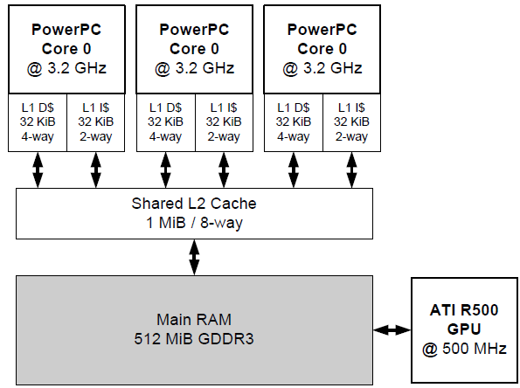
Xbox 360

Slide 36
PlayStation 3
Uses the Cell Broadband Engine (CBE) architecture
Uses multiple processors each of which is specially designed
The Power Processing Unit (PPU) is a PowerPC CPU
The Special Processing Units (SPU) are based on the PowerPC with reduced and streamlined instruction sets also has 256K of L1 speed memory
Communication done through a DMA bus which does memory copies in parallel to the PPU and SPUs

Slide 37
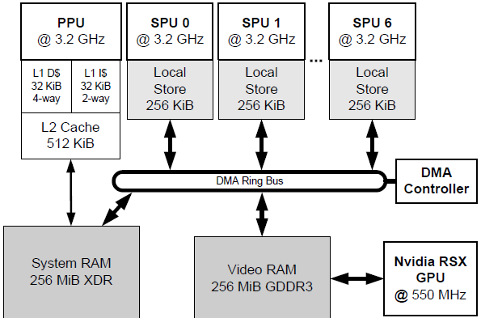
PS3

Slide 38
PlayStation 4
Very different from Cell architecture
Utilizes an eight core AMD Jaguar CPU
  Has built in code optimization
Modern GPGPU
  Close to an AMD Radeon 7870
Uses Intel instruction set instead of PowerPC
Shared 8GiB block of GDDR5 Ram
Employs three buses
  20 GiB/second CPU->RAM bus
  10GiB/second “onion” bus between the GPU and CPU caches
  176 GiB/second “garlic” bus between the GPU and RAM

Slide 39
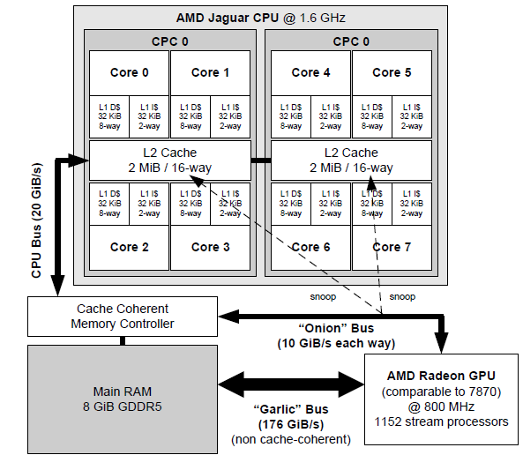
PS 4

Slide 40
Xbox One
Very similar to the PS 4 – both based on the AMD Jaguar
Important differences
  CPU Speed: 1.75 Ghz vs 1.6 Ghz on the PS4
  Memory type: GDDR3 RAM (slower), but has 32MiB eSRAM on the GPU (faster)
  Bus Speed: faster main bus (30GiB/sec vs 20GiB/sec)
  GPU: not quite as powerful (768 processors vs 1152 processors), but runs faster (853Mhz vs 800 Mhz)
  OS and ecosystem: Xbox Live vs PlayStation Network (PSN). Really a matter of taste

Slide 41
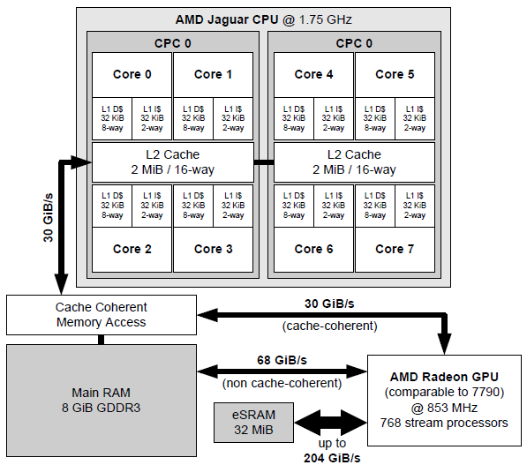
Xbox One

Slide 42
Seizing the power
Fork and Join
  Split a large task into a set of independent smaller tasks and then join the results together
One thread per subsystem
  Each major component runs in a different thread
Jobs
  Divide into multiple small independent jobs

Slide 43
Fork and Join
Divide a unit of work into smaller subunits
Distribute these onto multiple cores
Merge the results

Slide 44
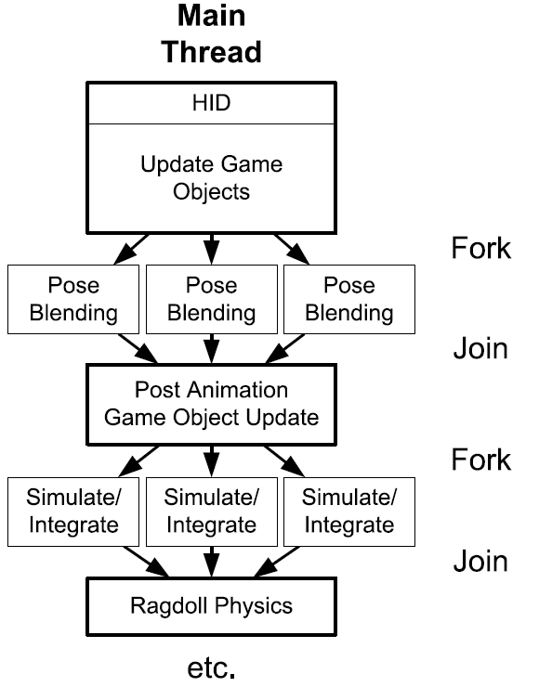
Fork and Join

Slide 45
Example
LERPing can be done on each joint independent of the others
Imagine having 5 characters each with 100 joints that need to have blended poses computed
We could divide the work into N batches, where N is the number of cores
Each computes 500/N LERPs
The main thread then waits (or not) on a semaphore
Finally, the results are merged and the global pose calculated

Slide 46
Thread per Subsystem
Have a master thread and multiple subsystem threads
  Animation
  Physics
  Rendering
  AI
  Audio
Works well if the subsystems can act mostly independently of one another

Slide 47
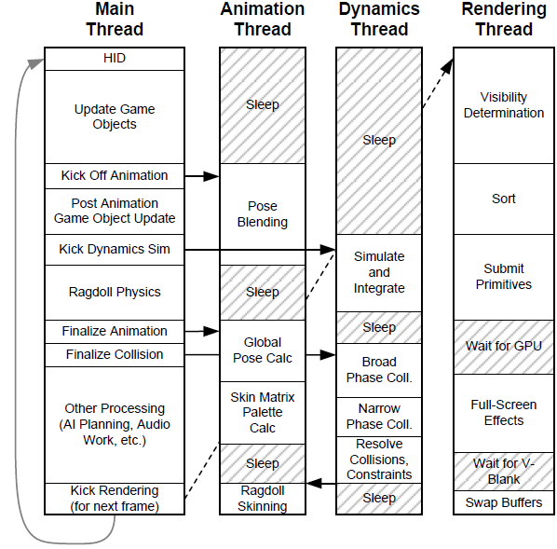
Thread per subsystem

Slide 48
Jobs
Multithreading can sometimes be too course grained
  Cores sit idle
  More computational threads can block other subsystems
We can divide up large tasks and assign them to free cores
Works well on the PS3 – uses SPURS model for task assignment to the SPUs

Slide 49
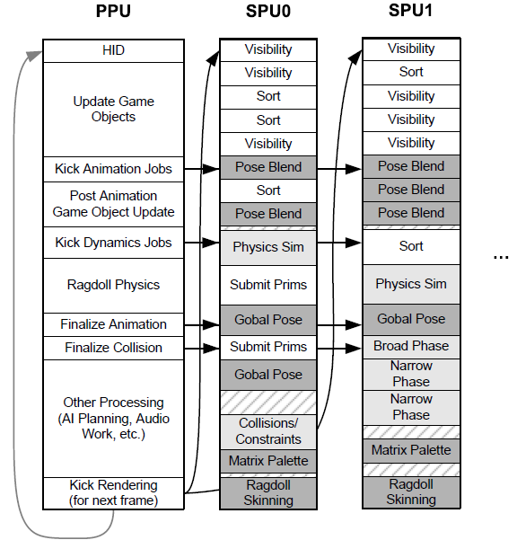
Jobs

Slide 50
Networked Multiplayer Game Loops
Client-Server
  Can be run as separate processes or threads
  Many games use a single thread
    The client and server can be updating at different rates
Peer-to-Peer
  Each system acts as a client and server
  Only one systems has authority over each dynamic object
  Internal details of the code have to handle the case of having authority and not having authority for each object
  Authority of an object can migrate

