Slide 1
Game Engine Architecture
Chapter 8
Human Interface Devices

Slide 2
Overview
Types of input devices
Interfacing with a HID
Types of input
Types of output
Game engine HID systems

Slide 3
Types of HIDs
Consoles typically come with a Joypad device
Computers often use the keyboard and mouse
Arcade games have very specialized input
Many specialized devices
Guitar Hero
Dance Dance Revolution
Modifiers on existing devices
Steering wheel for WiiMote

Slide 4
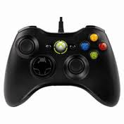
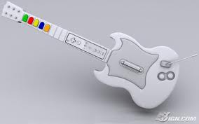
Types of hids

Slide 5
Interfacing to a HID
Depends on the device
Polling – reading the state once per iteration
Hardware register
Memory mapped I/O port
Using a higher level function
XInput on the XBox 360 is a good example
Call XInputGetState() which returns a XINPUT_STATE struct

Slide 6
Interfacing
Interrupts
Triggered by a state change in the hardware
Temporarily interrupts the CPU to run a small piece of code
Interrupt Service Routine (ISR)
ISRs typically just read the change and store the data
Wireless
Many of the wireless controllers use Bluetooth to communicate
Software requests HID state
Usually handled by a separate thread
Looks like polling to the application developer

Slide 7
Type of input
Digital Buttons
Have two states
Pressed represented by a 1
Not pressed represented as a 0
Depends on the hardware developer
Often the button state is combine into one struct

Slide 8
Xinput_gamepad
typedef struct _XINPUT_GAMEPAD {
WORD wButtons;
BYTE bLeftTrigger;
BYTE bRightTrigger;
SHORT sThumbLX
SHORT sThumbLY
SHORT sThumbRX
SHORT sThumbRY
}
xButtons contains the state of all the buttons and you apply masks to get their current state
(pad.wButtons & XINPUT_GAMEPAD_A) != 0

Slide 9
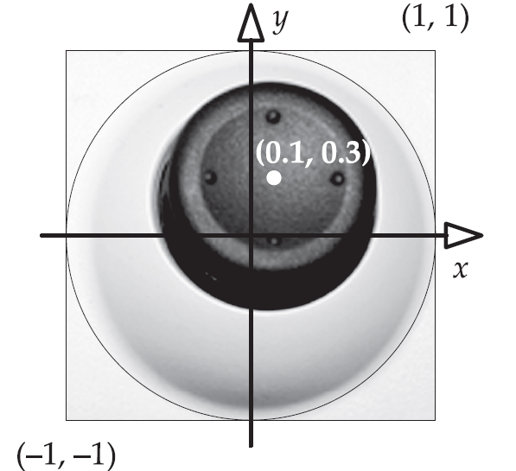
Analog axes and buttons
Unlike buttons, joysticks have a range of values
They aren’t truly analogy because they are digitized
Range from -32,768 to +32,767
or -1 to +1
In the Xbox XINPUT structure the joysticks are represented using 16-bit signed integers

Slide 10
Relative axes
Most of the time the position of the trigger, joystick, or thumb stick is absolute – relative to a 0,0 point
Some input devices provide information in a relative format
They return 0 if the device has not moved from its past position
Examples include mice, mice wheels, and track balls

Slide 11
Accelerometers
Newer controllers have accelerometers built in
These provide information about g-force in three directions
Can measure up to 3g
These are relative measures – when not accelerating the return is 0

Slide 12
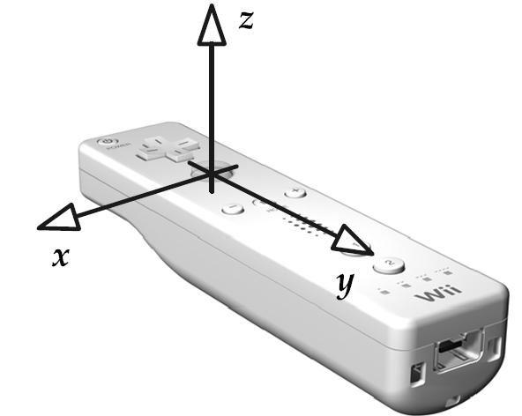
WiiMote and DualShock
One issue is that the accelerometers don’t give you orientation information
One way to do it is to remember that gravity has 1g of force in the downward direction
If the player holds the device still, you can calibrate the device based on which axis is experiencing 1g of force

Slide 13
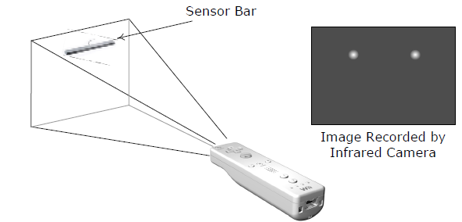
Cameras
The Wii uses a very low resolution IR camera to read the location of the WiiMote
WiiMote has two IR leds
The distance between the two dots, the size of the dots, and the relative position of the dots provides a lot of information about where the mote is pointing
Other examples include the Sony EyeToy and Xbox Kinect

Slide 14
Camera input

Slide 15
Types of output
Rumble
Usually one or two motors with a unbalanced weight
Can control the speed to create different feels
Force feedback
A motor attached to the HID that resists input from the user
Audio
WiiMote has has low-quality speaker
DualShock 4, Xbox 360 and Xbox One controllers have headphone jack
Others
Some have LEDs that can be controlled via software

Slide 16
Game HID systems
Most game engine massage the data coming in from the controllers
Allows for player remapping
Smooth control
Chords
Sequences

Slide 17
Typical requirements
Dead zones
Analog signal filtering
Event detection
Detection of sequences and chords
Gesture detection
Management of multiple HIDs
Multiplatform HID support
Controller input re-mapping
Context sensitive inputs
The ability to disable certain inputs

Slide 18
Dead zones
Analog devices are noisy by nature
When the joystick isn’t moved, the value returned fluctuates around 0,0 but is rarely stable
Dead zones allow the developer to clamp values within a small range $\left[I_{0},I_{o}+δ\right]$to the value 0

Slide 19
Analog signal filtering
Even with dead-zone clamping, the noise from the analog input can cause the motion to be jerky
Noise is usually high-frequency so we can isolate user input by using a low-pass filter
$$f\left(t\right)=\left(1−a\right)f\left(t−Δt\right)+au(t)$$
$$a=\frac{Δt}{RC+Δt}$$
filtered
unfiltered

Slide 20
Low-pass filter
F32 lowPassFilter(F32 unfilteredInput,
F32 lastFramesFilteredInput,
F32 rc, F32 dt)
{
F32 a= dt / (rc +dt);
return (1-a) * lastFramesFilteredInput
+ a * unfilteredInput;
}

Slide 21
Moving average
An equally interesting way of filtering the data is to use a moving average
This can be done using a circular queue that maintains the last n values
You can also keep the running sum by adding the new value and subtracting the one it is replacing in the queue

Slide 22
Input event detection
The easiest way to detect a change to states is to keep the previous state and XOR it with the current state
XOR produces a 1 when the state has changed
We can then mask out the up events and the down events by using AND
ANDing the original state with the changed state gives us the DOWNs
NANDing gives us the UPs

Slide 23
Chords
Chords are combinations of button presses
A+B at the same time
Easy to create masks for chords, but there are some subtle issues
Users aren’t perfect in the timing of the presses
The code must be robust to not triggering the non-chord events too
Lots of ways to resolve these
Design button inputs so the chord does the individual actions plus something else
Introduce a delay in processing individual inputs so a chord can form
Wait for button release to start an event
Start a single button move right away and override it with a chord move

Slide 24
Sequences and gestures
Sequences are usually done by storing the input events and tagging them with time
When the next button is pressed, determine if the time for the sequence has expired or if the sequence is invalid
Can be used for
Rapid button tapping
Button sequences
Thumb stick rotations
Good sample code in the book for all of these

Slide 25
Multiple HIDs
This just involves mapping the correct input to the correct player
Also involves detecting HID changes due to serious events
Controller unplugged
Batteries dying
Player being assaulted

Slide 26
Cross platform HIDs
Two main ways to handle this
Conditional compilations – YUCK messy code
Hardware abstraction layer
Create your own input classes and add a translation layer
Certainly superior because it is easy to add new HIDs

Slide 27
Input re-mapping
We can provide a very nice feature by adding in a few classes that create a level of indirection – input remapping
If we give names to events that have nothing to do with the input that triggers it, then we simple create an input to event lookup table
Requires us to normalize the input a bit
Think about keyboard versus mouse for aircraft control

Slide 28
Context sensitive controls
Often the controls will trigger different events based on the situation
The “use” button is a classic case
One way to implement this is to use a state machine
In state “walking” L1 means fire primary weapon
In state “driving” L1 means turbo
When mixed with user re-mapping the system can become quite complex

Slide 29
Disabling inputs
One simple, but Draconian approach is to introduce a mask
When a control is disabled, set the bit to 0
The mask is then ANDed with the control input before further process
Make sure the bit gets set back to 1 again otherwise you loose control forever
Sometimes you want to disable it for a particular set of actions, but other systems might want to see it...

Slide 30
In practice
It takes a serious amount of time and effort to build an effective HID system.
It is super important because it radically affects game play

